Slide 1

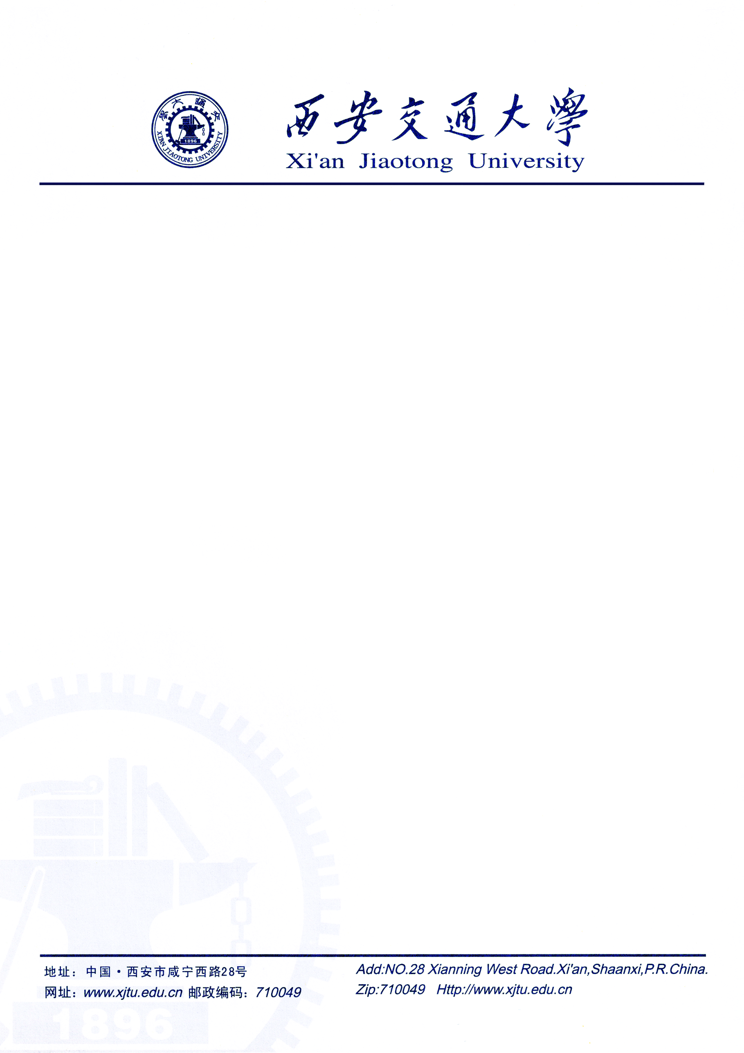
ATPP: A Mobile App Prediction System Based on Deep Marked Temporal Point Processes
Kang Yang¹, Xi Zhao², Jianhua Zou² , Wan Du¹
1
2

Slide 2
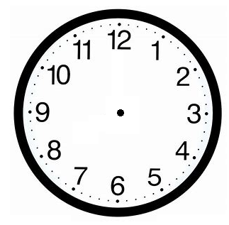

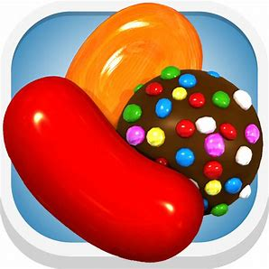





Mobile Application Usages
2

Slide 3

Mobile Application Usages
Can we predict both next app and its open time jointly?
3

Slide 4

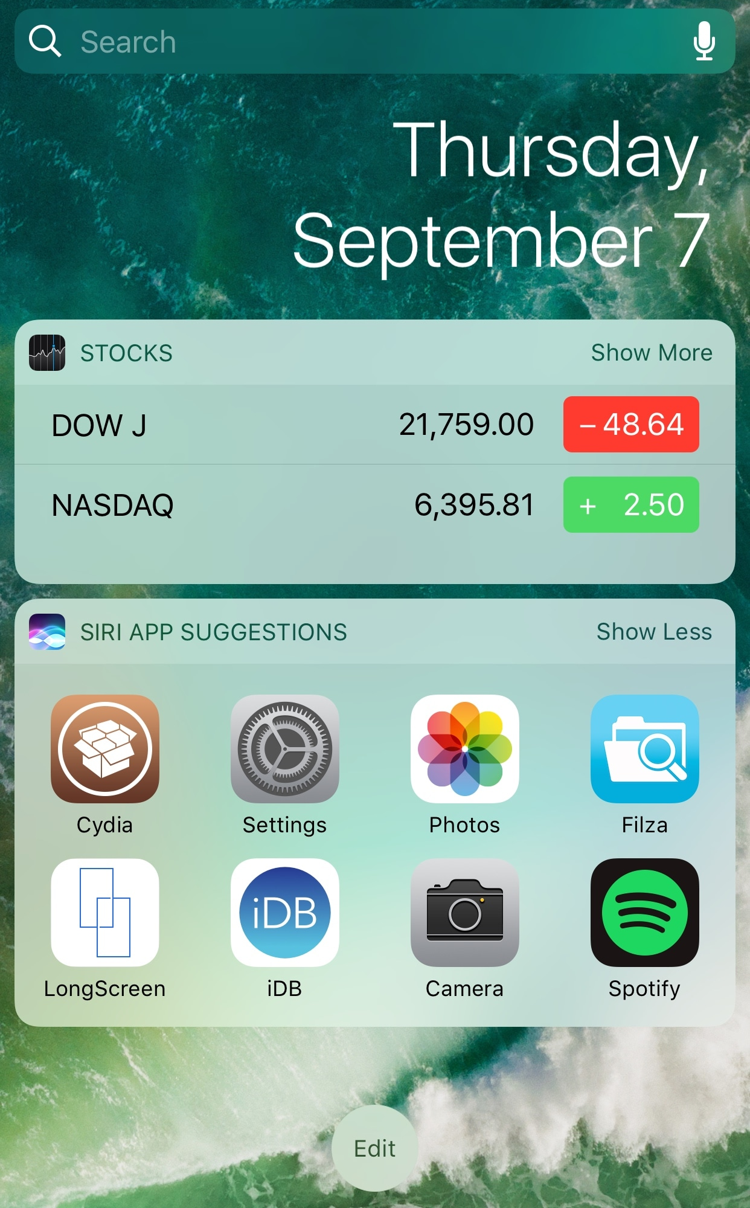

Mobile Application Usages
Loading 83 %
Fast Apps launching
Fast Apps searching
4

Slide 5
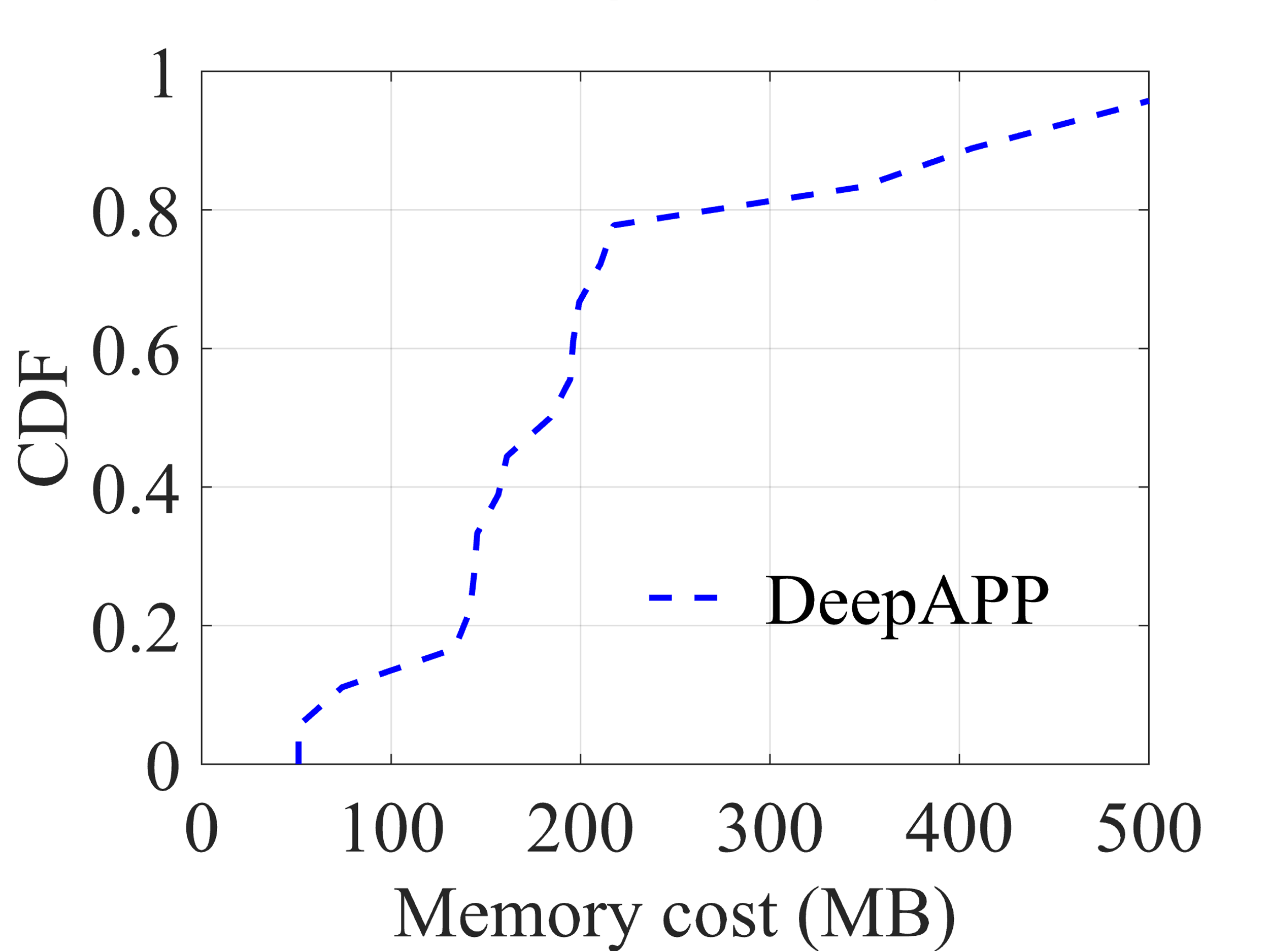
Mobile Application Usages
Time prediction is important to avoid loading the next app too early
7% of the memory of the smartphone each day
Z. Shen*, K. Yang*, W. Du, X. Zhao, and J. Zou, DeepAPP: a deep reinforcement learning framework for mobile application usage prediction, in ACM SenSys, 2019. Extended to IEEE Transactions on Mobile Computing. (*equal contribution)
5

Slide 6

Deep Reinforcement Learning for App Prediction (DeepAPP)
App prediction agent server
Smartphone
Context-aware module
  Predicting the apps that a user will open in the next 5 minutes.
  Input: current app, location and time.
Contextual environment
Agent
Policy
State
User
interface
Predicted results
Reward
action
Feedback
Scheduler
module
Z. Shen*, K. Yang*, W. Du, X. Zhao, and J. Zou, DeepAPP: a deep reinforcement learning framework for mobile application usage prediction, in ACM SenSys, 2019. Extended to IEEE Transactions on Mobile Computing. (*equal contribution)
6

Slide 7



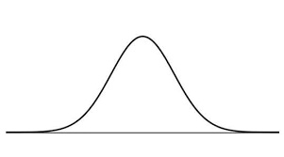
Temporal Point Processes for App Prediction
A random process whose realization consists of discrete events localized in time.
apps
time
History
probability density function
7

Slide 8
Temporal Point Processes for App Prediction
Intensity Function
event number
A user opens 3 apps from 10:00AM to 10:05 AM
Junchi Yan, IJCAI2019 Tutorial: Learning Temporal Point Process
8

Slide 9
Temporal Point Processes for App Prediction
Similar simple example:
Gaussian distribution
Hawkes process:
baseline intensity
triggering function
Alpha controls the likelihood of an event causing another event
Omega controls the rate of decaying influence from previous events
9

Slide 10
Temporal Point Processes for App Prediction
Parameter inference:
Maximum Likelihood Estimation (MLE)
(log-)likelihood that generates a specific events sequence
Prediction:
the probability density function
O. O. Aalen, Ørnulf Borgan, and H. K. Gjessing, Survival and event history analysis : a process point of view. Springer Science & Business Media, 2008.
10

Slide 11
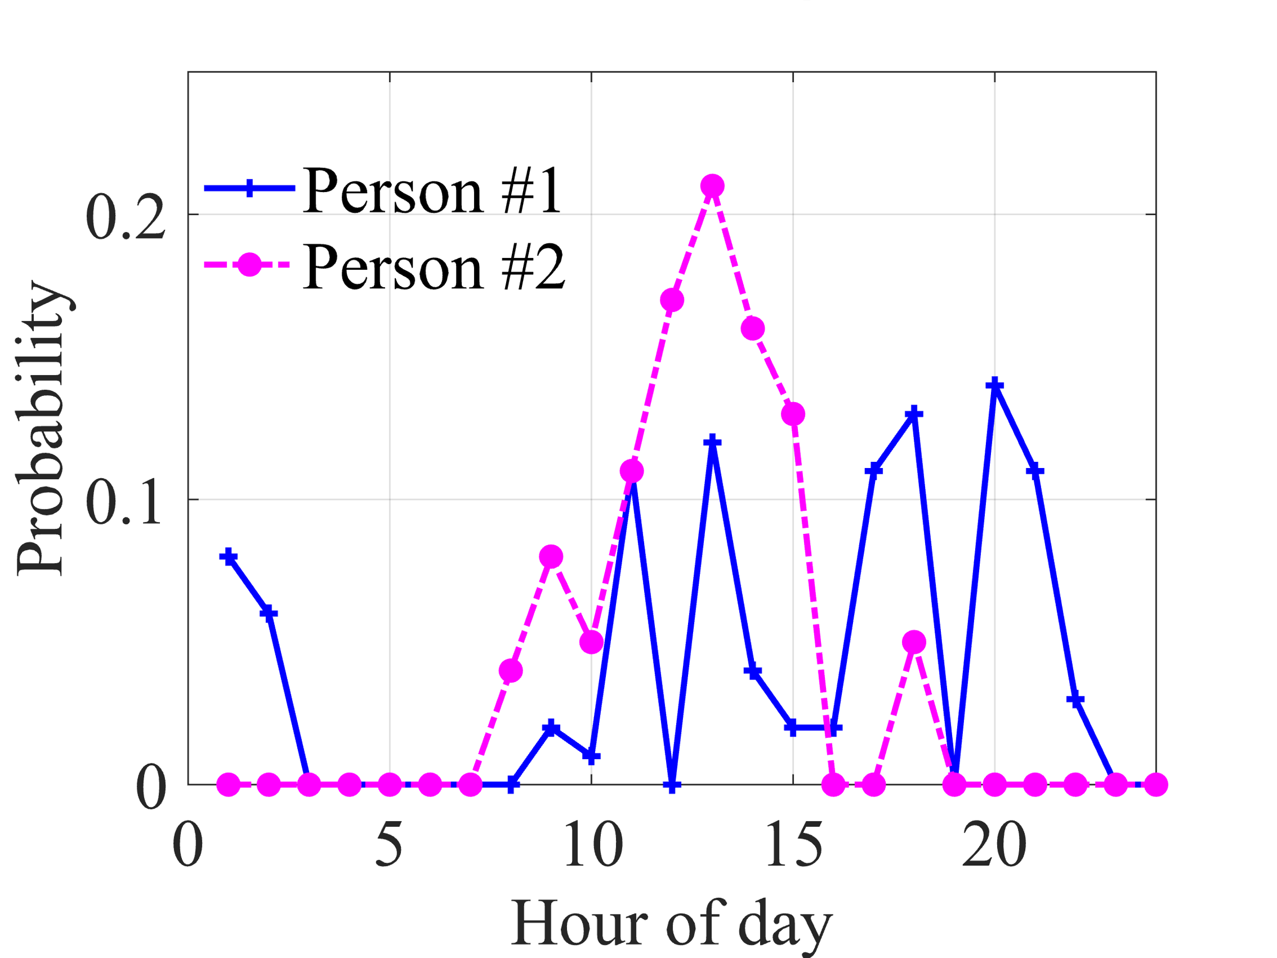
Limitations
Hawkes process:
Practical user patterns:
Strong Assumption
11

Slide 12
ATPP
The key idea is to use the powerful capacity of the neural network to learn the intensity functions with a stronger fitting ability.
12

Slide 13
ATPP
App Usage Event Sequence
Context-aware Optimization Module
Input
Integrate
App Representation
App-usage Event Predictor
App ID &
Open Time
13

Slide 14
RNN-based App-usage Event Predictor
RNN units
Softmax Layer
App ID
G
G
…
Temporal-app Vector
G
Fully-connected Layer
Open Time
Hawkes process
past
influence
current
influence
base
intensity
14

Slide 15
Context-aware Optimization Module
Drop-in app usage behavior
Amazon, WhatsApp, Amazon, ApplePay
443 anonymized users
21 days
15

Slide 16
Context-aware Optimization Module
Attention-based temporal feature extractor
Amazon, WhatsApp, Amazon, ApplePay
Temporal-app Vector
0.45
0.10
0.45
Attention Mechanism
G
G
…
G
Amazon
WhatsApp
Amazon
16

Slide 17
Trace-driven evaluation
Dataset:
  443 users.
  3 weeks.
  Two weeks for training and one week for validation.
17

Slide 18
Trace-driven evaluation
  Prediction accuracy.
  Performance gain of the proposed techniques.
  Parameter settings.
18

Slide 19
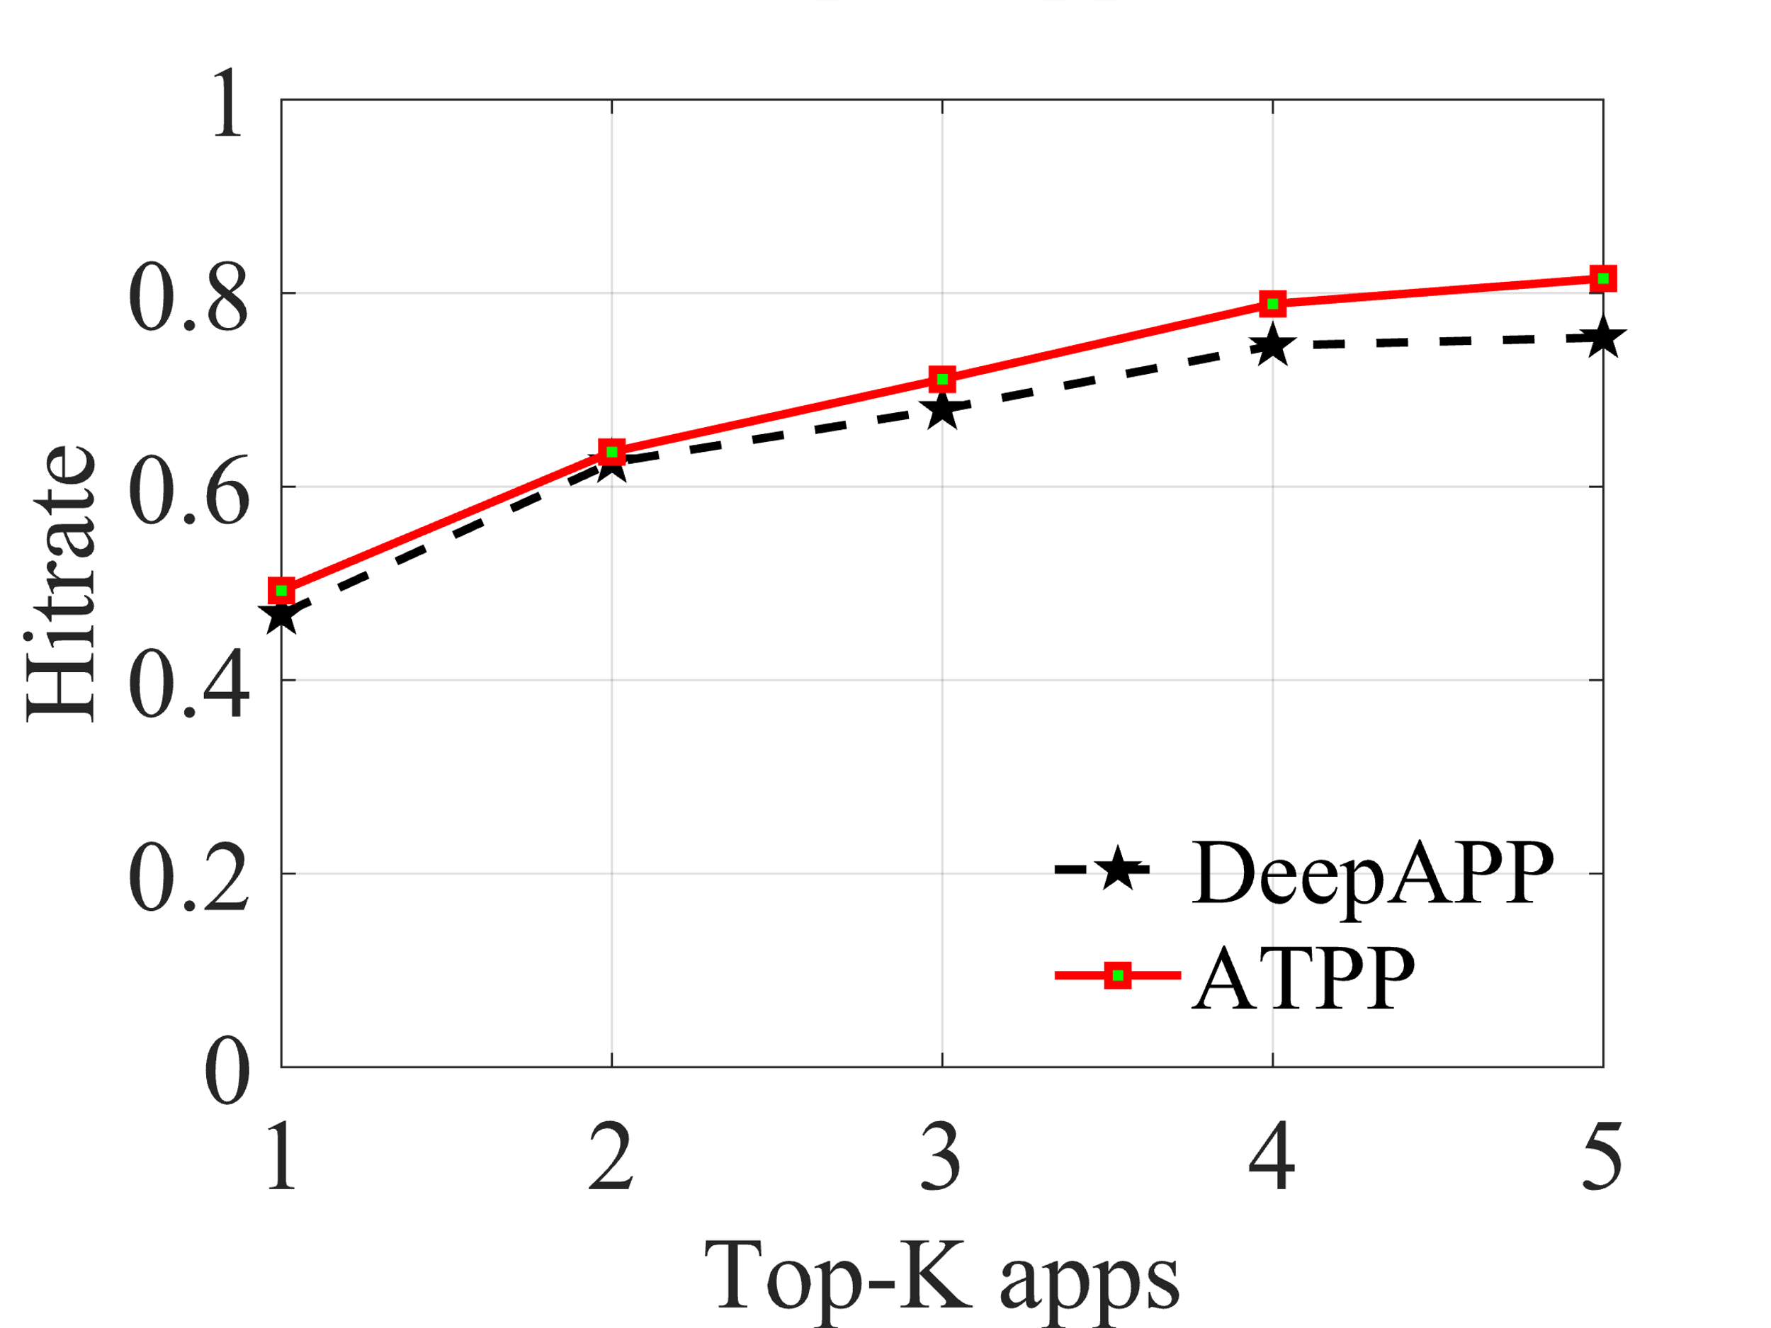
Overall accuracy - Hitrate
Z. Shen*, K. Yang*, W. Du, X. Zhao, and J. Zou, DeepAPP: a deep reinforcement learning framework for mobile application usage prediction, in ACM SenSys, 2019. Extended to IEEE Transactions on Mobile Computing. (*equal contribution)
19

Slide 20
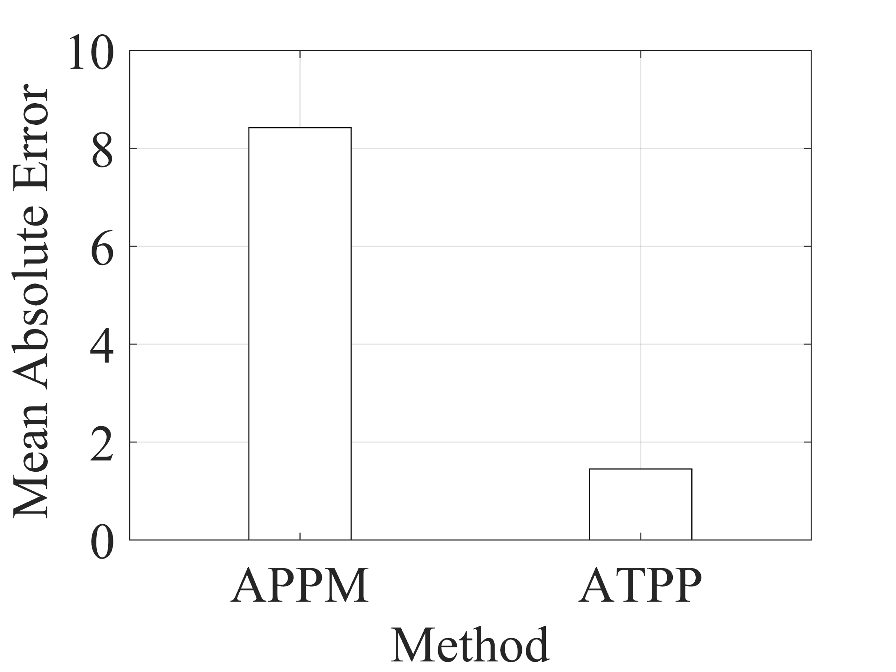
Overall accuracy - MAE
5.8×
A. Parate, M. B¨ohmer, D. Chu, D. Ganesan, and B. M. Marlin, Practical prediction and prefetch for faster access to applications on mobile phones, in ACM Ubicomp, 2013.
20

Slide 21
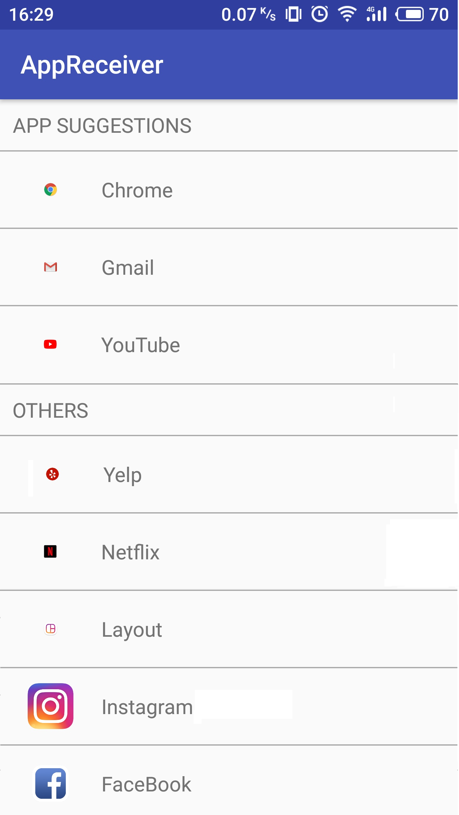
Field study
Participants:
  22 (7 females and 15 males)
  Students, teachers, and employees, etc.
  Aged from 19 to 48
  21 days
Goals:
  Measuring the in-field accuracy
  Evaluating the real user experience
21

Slide 22
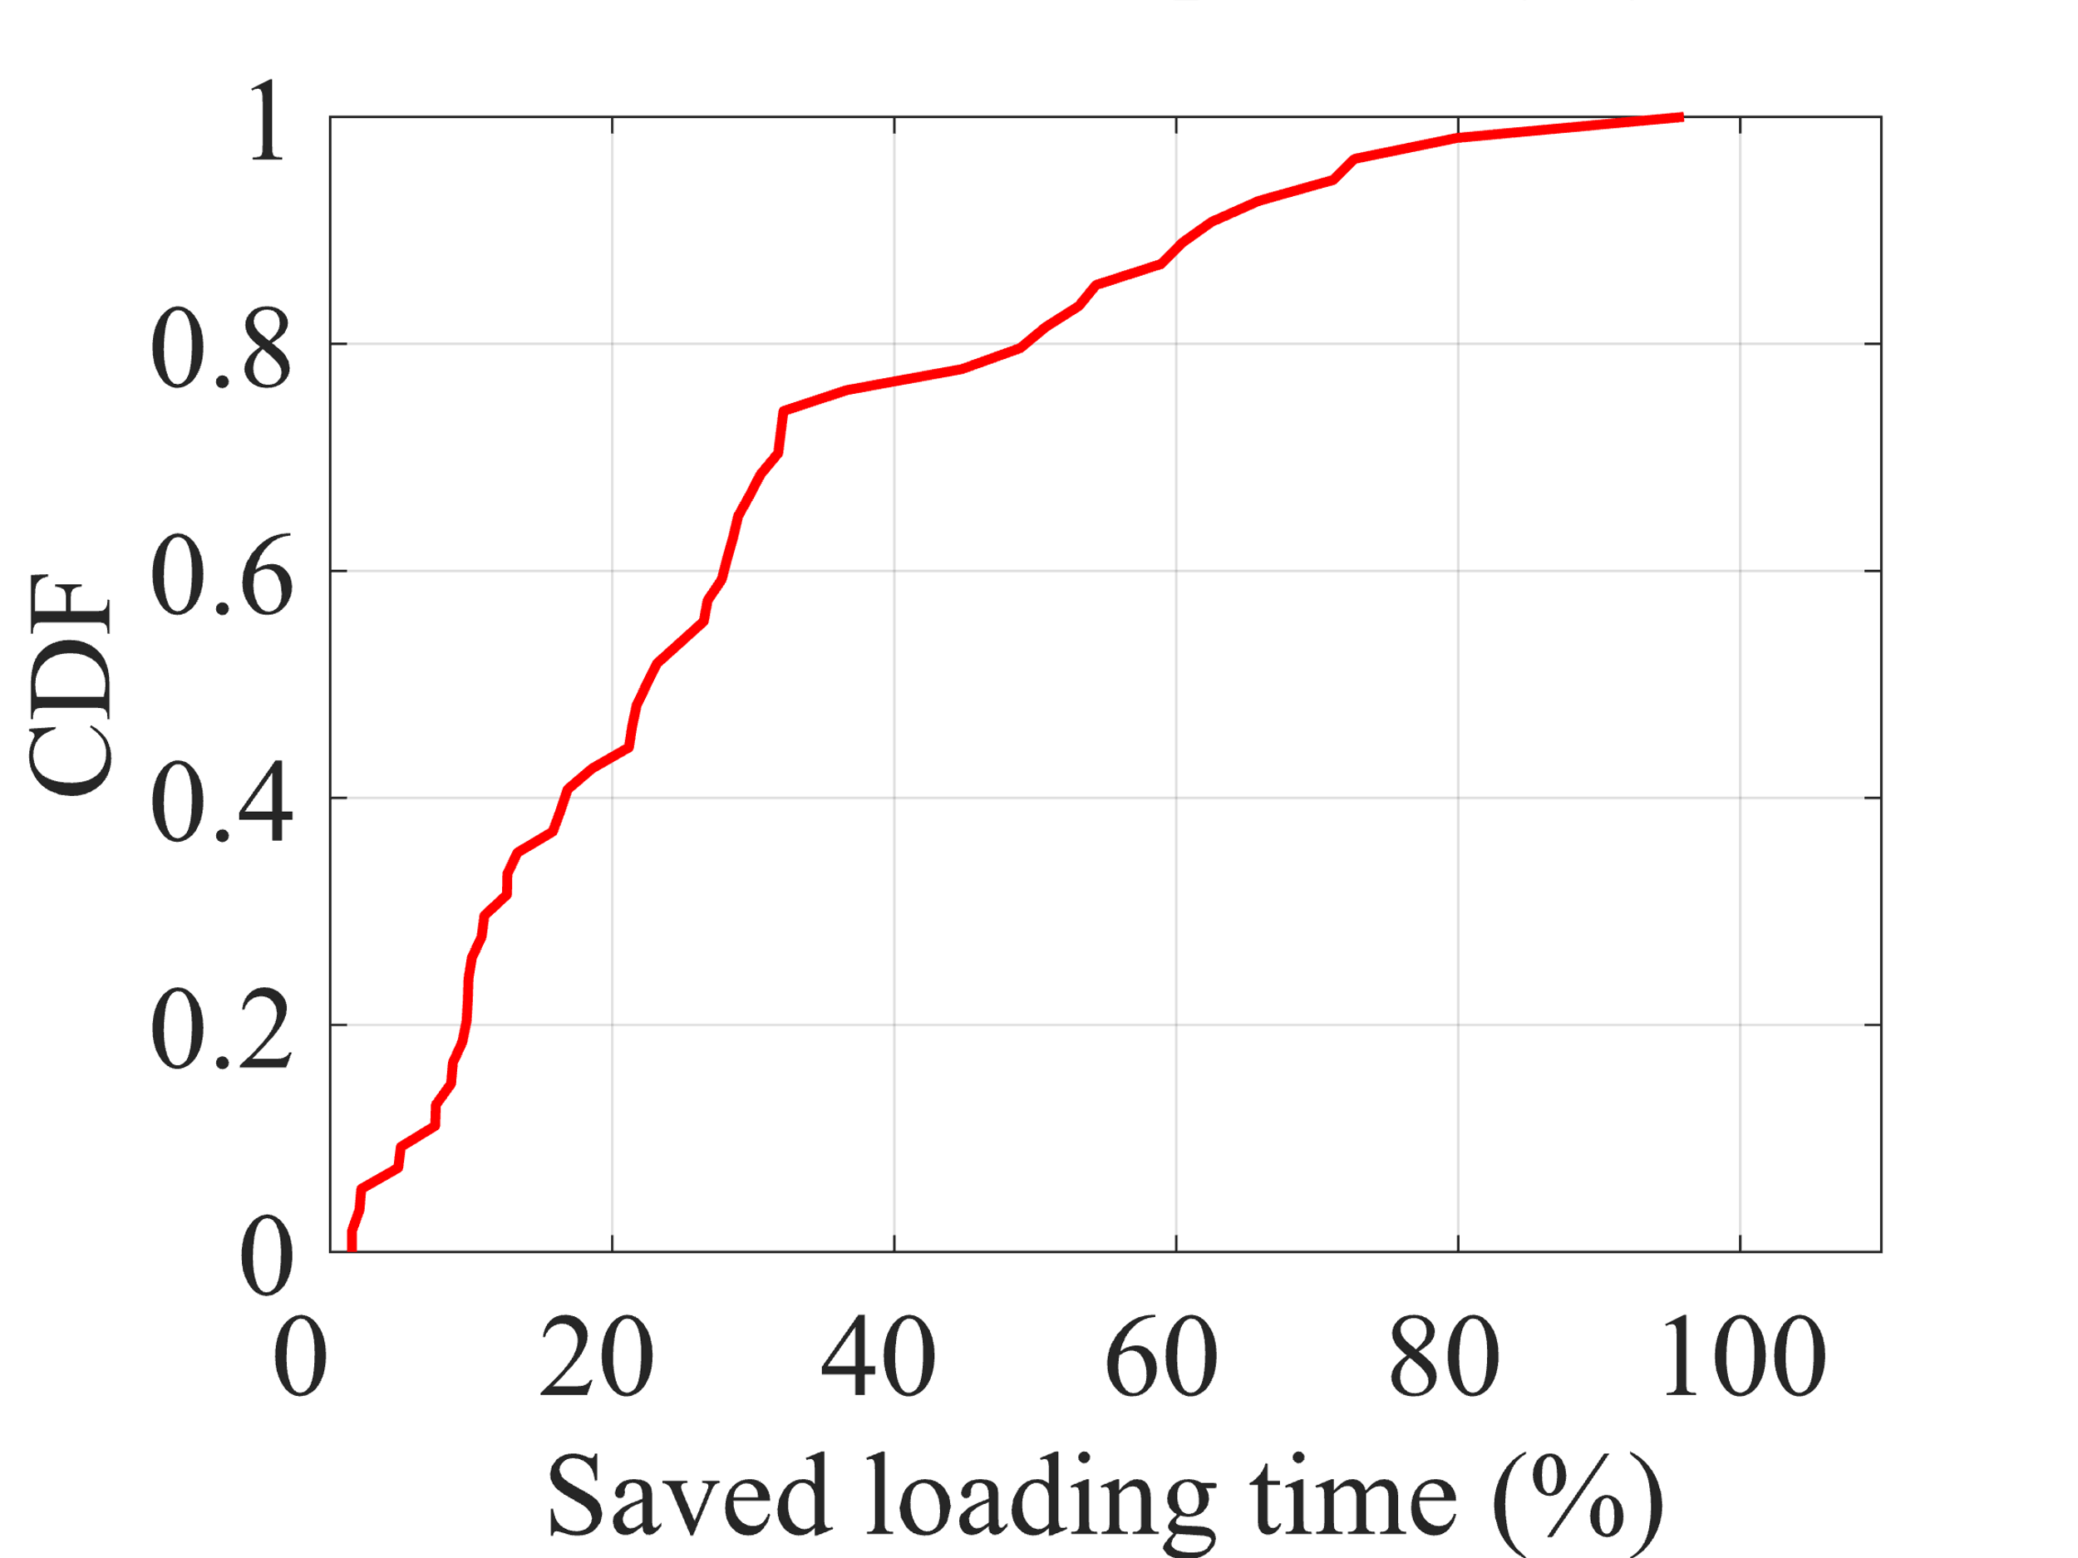
Field study
Performance analysis
22

Slide 23
Summary
An RNN-based MTPP app usage predictor to predict next app and open time jointly.
An attention-based temporal feature extractor to consider drop-in app usage behavior.
Extensive trace-driven experiments and a field study.
23

Slide 24
Thank you
24

