Slide 1
Link Quality Modeling for LoRa Networks in Orchards
Kang Yang*, Yuning Chen*, Xuanren Chen, Wan Du
（* denotes Equal Contribution）
ACM/IEEE IPSN 2023
Notes:
Hi everyone, I’m Yuning Chen, a PhD student from University of California, Merced. Today, I will present FLog, a link quality model for LoRa network in the orchard deployment scenario. This work is advised by Prof. Wan Du. Kang Yang is a fourth-year PhD student and we claim equal contribution, Xuanren was an undergraduate in our group. We are all from the Department of Computer Science in UC Merced.

Slide 2
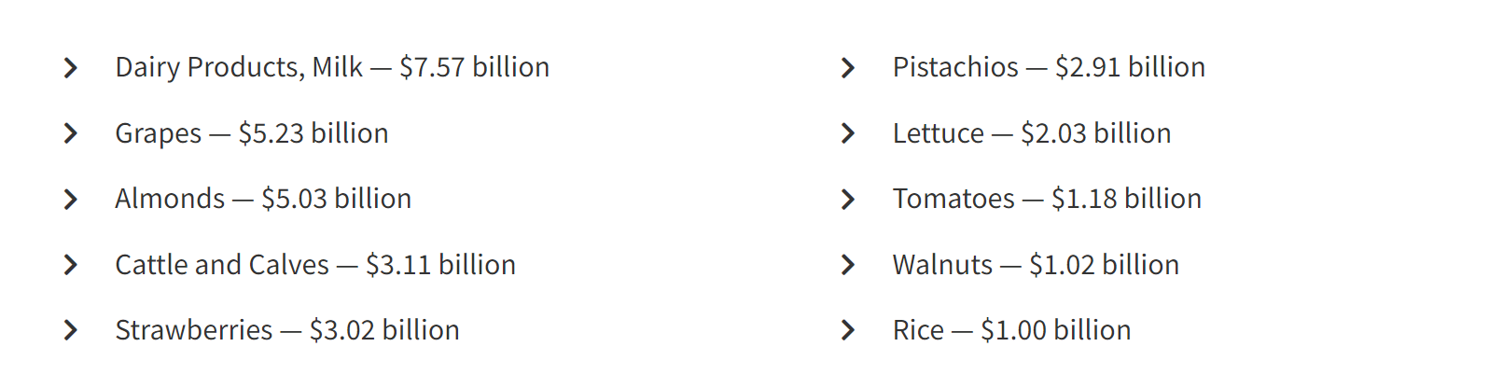
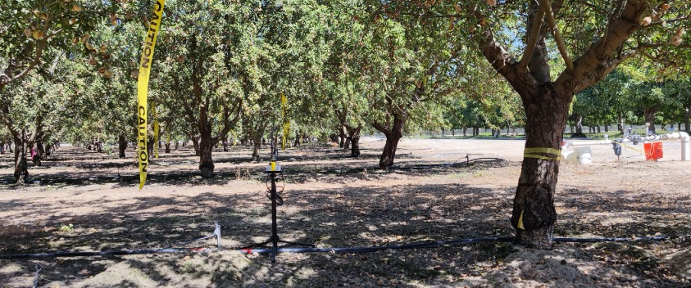
Wireless Network for Smart Orchard Management
Profits of Agricultural Productions in California, 2021:
Smart Irrigation
Pest Control
Tree Health Monitoring
…
Smart agricultural applications require wireless sensor networks.
source: https://www.cdfa.ca.gov/
Notes:
Orchard crops provide significant economical contributions.
Almonds, pistachios and walnuts can be sold for 9 billion dollars per year only for California, not to mention the world.
Despites the attractive economic values,, managing an orchard is not an easy task. There are many challenges that farmers face, such as optimizing yields and maintaining tree health. To overcome these challenges, many smart agricultural applications have been adopted, including smart irrigation, pest control, and tree health monitoring.
To facilitate information collection from the trees and environment, wireless sensor networks are essential. With these networks, farmers can remotely monitor and control their orchards in real-time, making management more efficient and effective.

Slide 3
Wireless Network Options in Orchard Scenario
 | Cellular | Wi-Fi | Multi-hop | LoRa
Energy Consumption
Communication Range
Service Fee
Maintenance
Notes:
Nowadays, there are several wireless technology options, for example, adding a cellular module for each sensor provides
a long-range and reliable communication
and is easy to maintain, but the high energy consumption and monthly fee hinder it from being adopted.
WiFi Local Area Networks require no service fee but are significantly short in communication distance. (double click)
Multihop mesh network leverages the relay functionality of each node to enable wide coverage(double click)
but it takes lots of effort to maintain. Finally, LoRa network wins out because of its low power, long-range, free ISM frequency band as well as easy maintenance. As a simple star topology is adequate for most applications, LoRa has gained prevalence from industry worldwide, to name a few, AllIoT from the UK and Semtech from the US.

Slide 4
Link Quality Estimation Requirement
Receiver (Gateway)
Sensor node
Link Quality Estimation is vital for link establishment and maintenance.
Notes:
For LoRa use cases,
the sensor nodes are set up near the ground or trunk to gather information.
According to our study, the Gateway should be set at a height of about 10 meters to achieve wide coverage, with a pole, tower, or tripods supporting it.To ensure a successful link establishment and assign proper transmission parameters, it’s required to estimate the link quality accurately.
The overestimation will cause deployment at dead points that are totally out of connection. While the underestimation will lead to the waste of transmission power or channel resources like Spreading Factors. Hence, link quality estimation is a necessary step for the deployment.

Slide 5
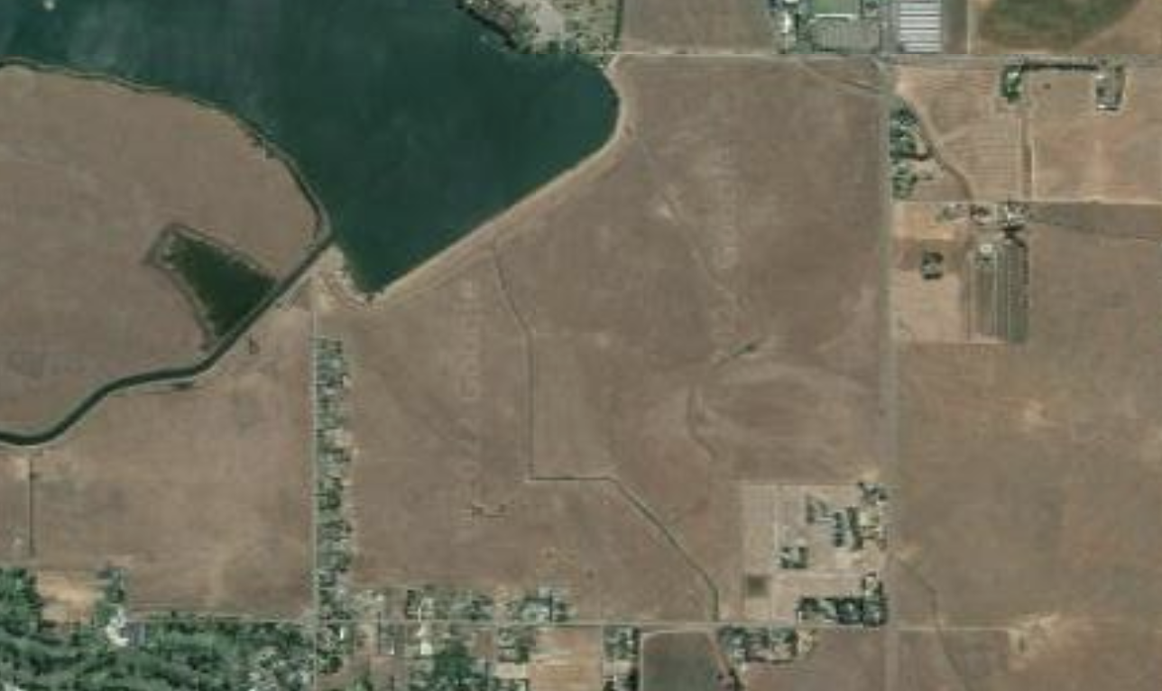
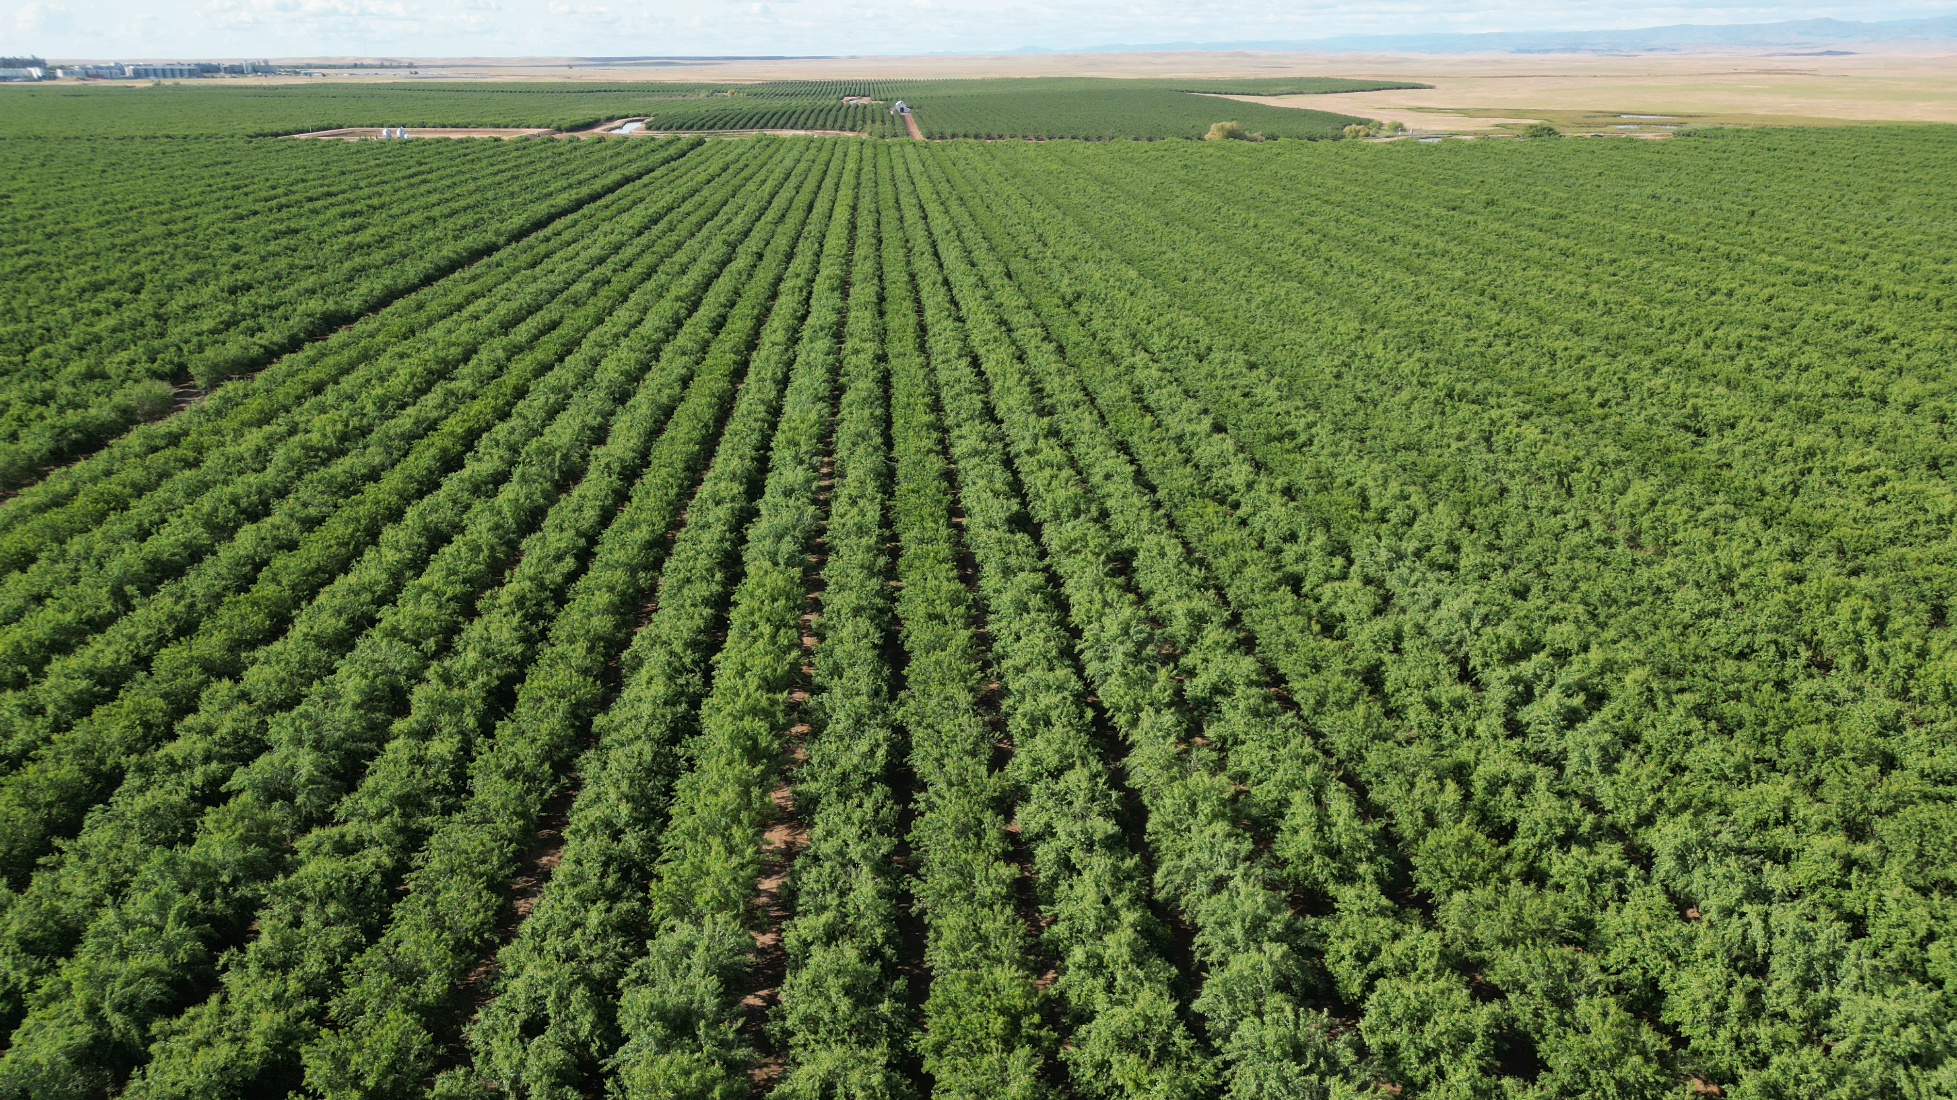
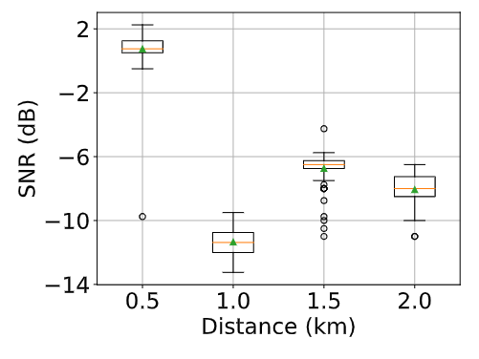
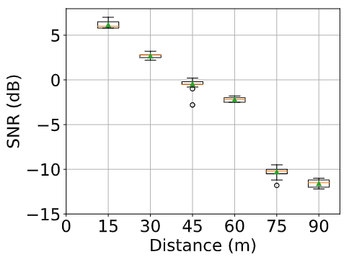
Gaps between Free Space and In-orchard Scenarios
0.5 km
1.0 km
Gateway
LoRa node
Gateway
LoRa node
2.0 km
1.5 km
Orchard foliage introduces large signal attenuation,
which the free space model can’t account for.
Notes:
So, what’s unique about the orchard scenario?
Here we made a comparison study between free space and in the orchards using SF10 and a transmission power of 14 dBm. In free space, We set up the distances between the gateway and sensor from 0.5 kilometers, 1 km, 1.5 km to 2 kilometers and find that the link quality at 2 km can still be perfect, with the Signal-to-noise ratio of about minus 8 dBm. For the orchard, we set the distance as 15 meters, 30 meters, all the way to 90 meters. The results show that the signal attenuates quickly with the distance increasing.
Comparing the link quality at 2 km in free space is much better than 90 meters in orchards, we can observe that
the dense foliage leads to large attenuation, which can’t be properly accounted for by the free space models.

Slide 6
State-of-the-art: Log-normal Shadowing Model (Log)
$$Path Loss(dBm)={PL}_{ref}+10 × PLE × \log_{10}\frac{d}{d_{ref}}$$
 | PLE
Free Space | 2
Urban Area Shadowing | 3-5
Building Obstruction | 4-6
Factory Obstruction | 2-3
$d$: Distance between the sender and receiver.
$d_{ref} :$(constant) Reference Distance, very short.
${PL}_{ref} :$Reference Path Loss at the reference distance.
$PLE :$ Path Loss Exponent, varies for different media, which is empirically set or fitted from measured data.
Notes:
The state of art path loss model that can work is Log-normal Shadowing Model, we will abbreviate it as Log.
It calculates the path loss like this:
d is the distance between the sender and receiver,
while dref is a constant short Reference Distance, usually set as 1meters. The larger d is, the more path loss will be.
PLref is the reference path loss, which refers to the path loss when d equals dref.
The most important part PLE refers to Path Loss Exponent, which is a parameter related to the media. It’s usually empirically picked from such tables
or calculated from measured data. Specifically, for each packet reception, we can measurena path loss and d to calculate the PLE for a certain environment.

Slide 7
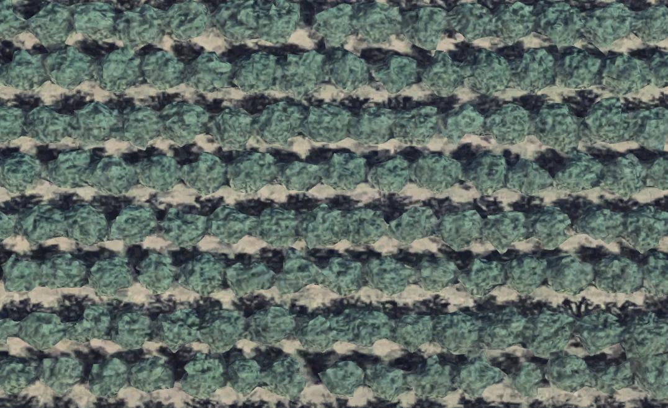
Challenge in Link Heterogeneity
The Expected Signal Power (ESP) indicates the received signal strength.
$${90}^{°}$$
$${75}^{°}$$
$${60}^{°}$$
$${45}^{°}$$
$${30}^{°}$$
$${15}^{°}$$
$$80m$$
$$0^{°}$$
Link quality (ESP) varies significantly in different directions.
Notes:
Now Let’s see the performance and lessons we learned from Log model.
Here we use Expected Signal Power (ESP) tp indicate the signal strength at the receiver side. In this experiment, the distance remains always the same as 80 meters, we only change the directions. We choose this direction parallel to the tree’s arrangement as reference, named 0 degree, taking 40 packets receptions, then set it at 15 degrees to measure packet receptions, then 30 all the way to 90.
We can observe in the right figure that Link quality varies significantly in different directions. From minus 105 to minus 118 dBm. The red dashed horizontal line is the average ESP value and the black solid line is the estimation from Log. Although Log fits the mean value closely, it loses the chance to be aware of the heterogeneity in directions.

Slide 8
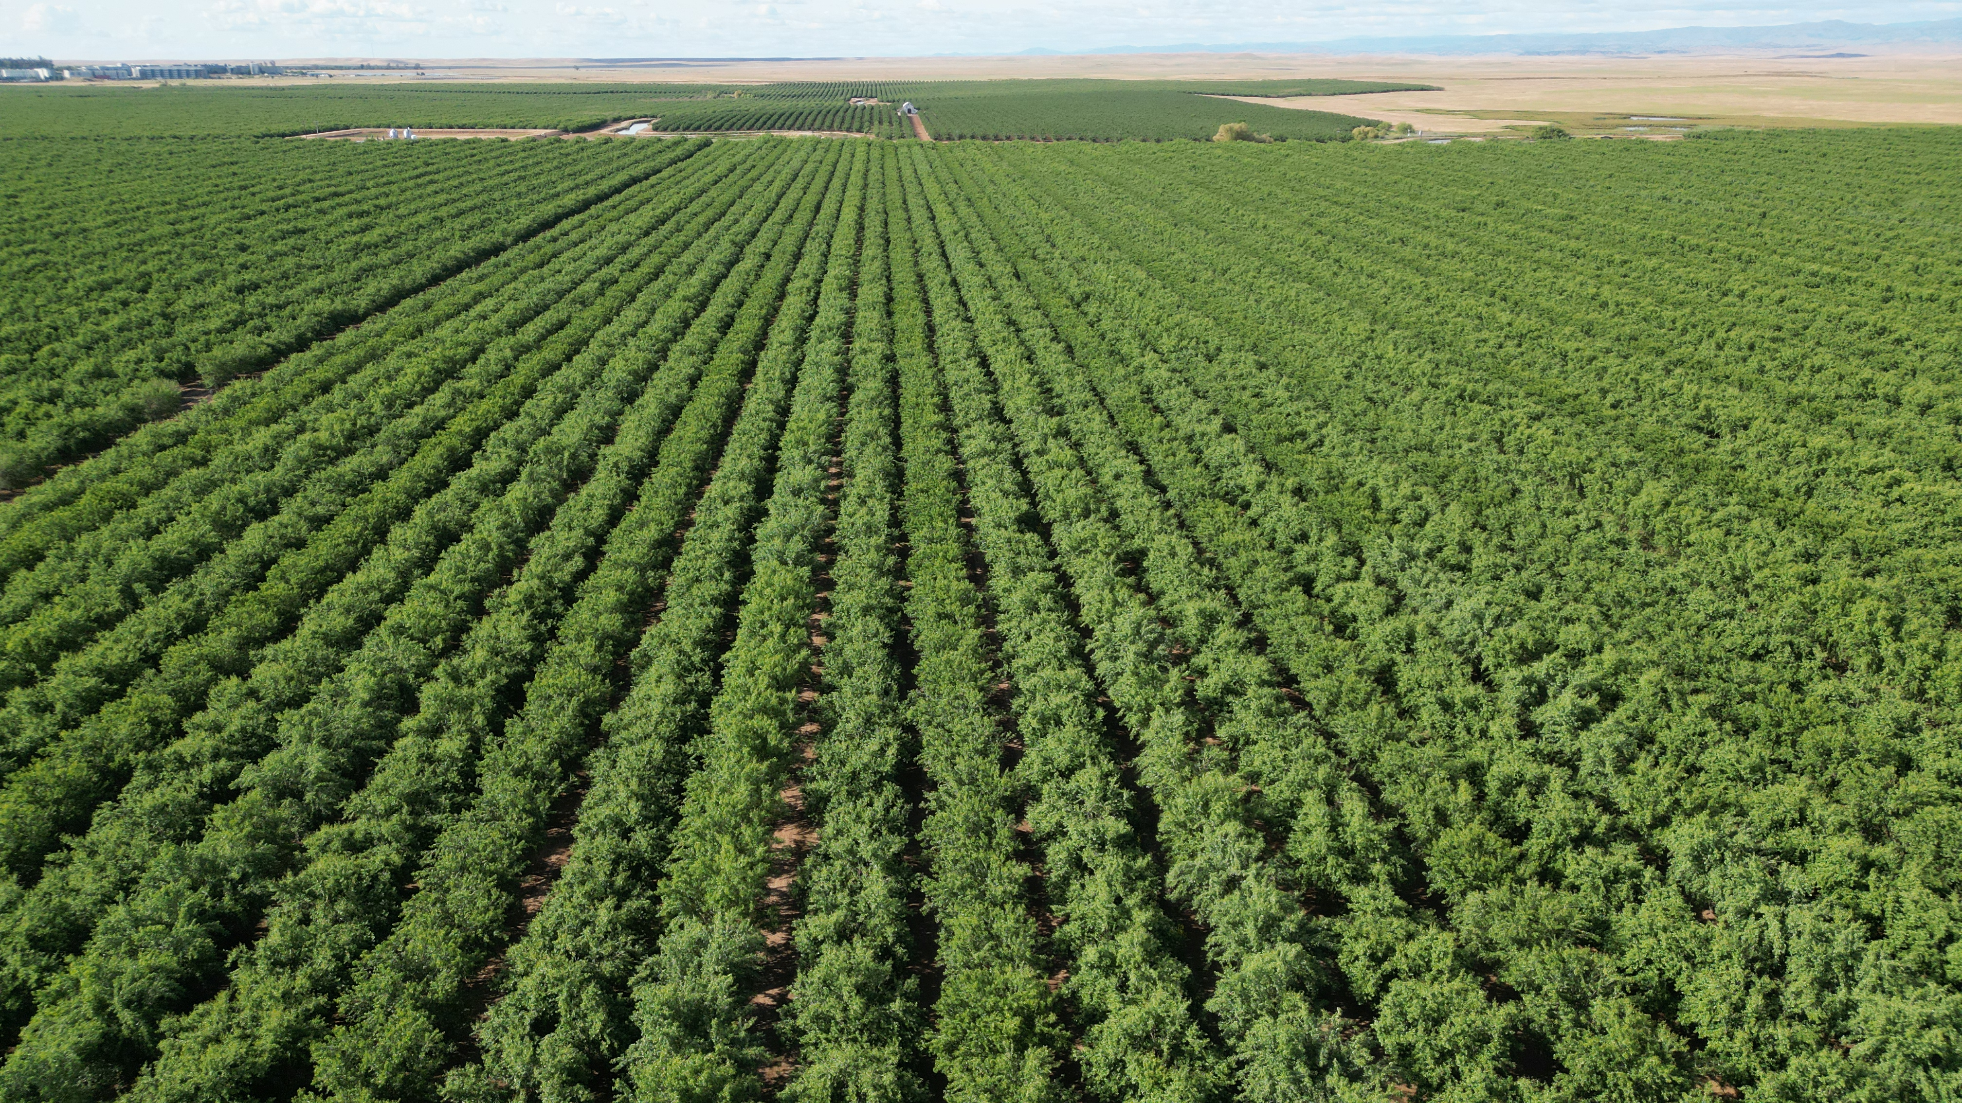
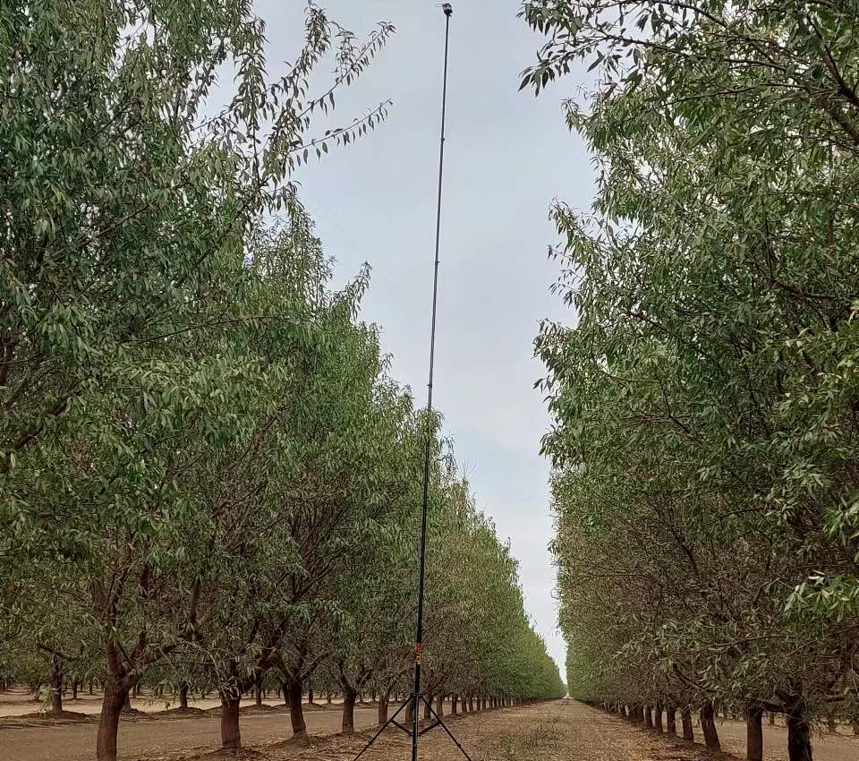
Possible Reason for Link Heterogeneity
Severe visual blocks
The obstruction varies for different directions.
Clear visual sight
Notes:
One possible reason lies in the

Slide 9
Strawman solution LineLog (LLog)
Section the line to calculate media portions.
Fit the PLE for the free space and foliage, respectively, with least-square fitting.
Open space path section
Foliage path section
Gateway
LoRa node
$${Portion}_{open}=\frac{length in open space}{d}$$
$${PLE= α×Portion}_{open}+{β×Portion}_{foliage}$$
$${Portion}_{foliage}=\frac{length in foliage}{d}$$
$α$: PLE for open space.
$β$: PLE for foliage.
${Portion}_{open}+{Portion}_{foliage}$ = 1
Notes:
To handle the Heterogeneity in shadowing effects, we designed a strawman solution Line-Log, abbreviated as LLog, that sections the line between the node and gateway into multi-parts in different media, specifically, open space or through-foliage. Then the portion of open space is calculated as

Slide 10
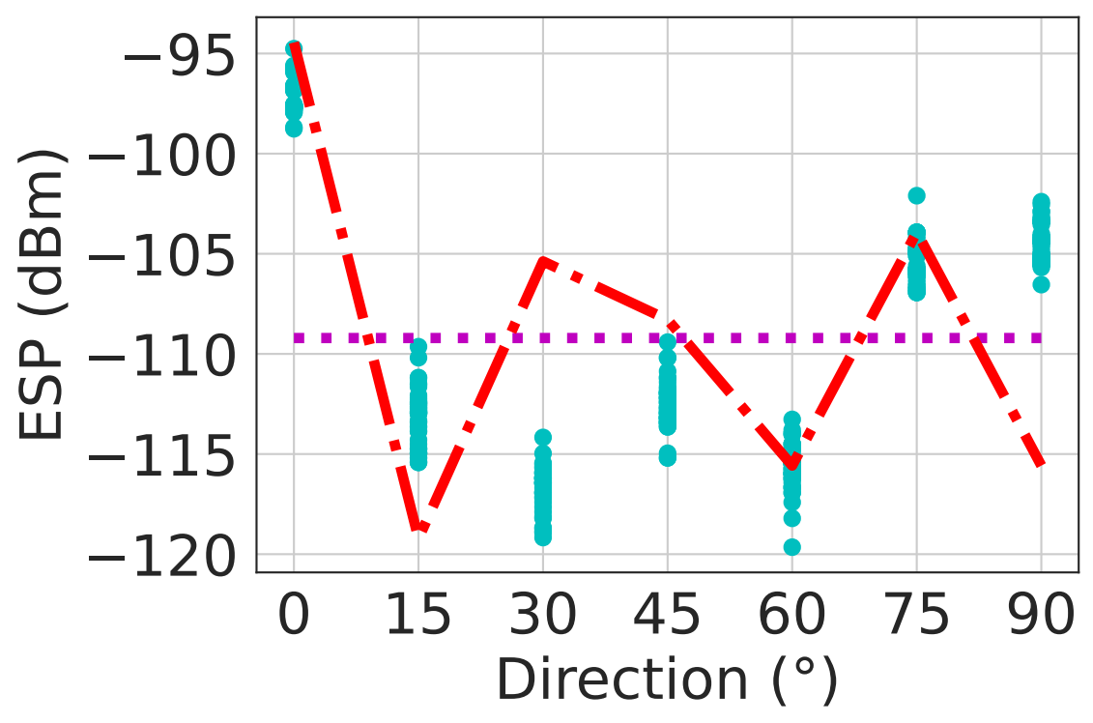
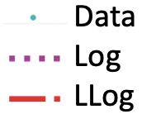
Performance and hypothesis in LineLog (LLog)
Does the power of the LoRa signal propagate
mainly on the straight line
in the orchard?
Notes:
Let’s look at the strawman solution performance in one distance but with different directions. Here each blue dots represent one packet information, Since the distance is the same, the Log prediction is still a horizontal line. LLog is marked as a red dashed line in the figure can provide different estimations in different directions, but underestimation and overestimation occur in many sites and brings large misleading errors.
Why is it? We attribute this to the improper hypothesis that models the path as a straight line. And here comes the question,
Does the power of the LoRa signal propagate mainly on the straight line in the orchard?
To answer this question, we conducted an experiment to further analyze

Slide 11
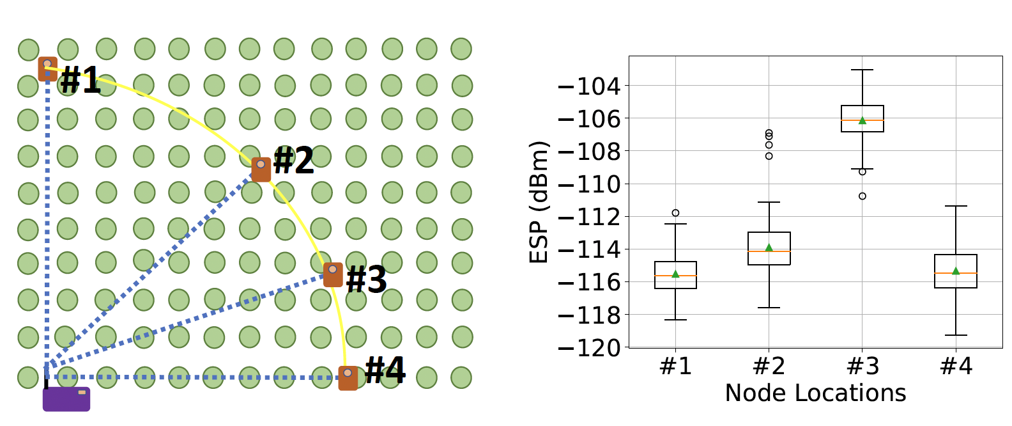
Performance Analysis for LLog
Line of Sight
Non-Line of Sight
Straight Line is not deterministic for shadowing effect in the orchard.
Notes:
To understand the impact of the obstructions in the straight line, we choose 4 sensor location settings in different directions with the same distance. Both the gateway and node are set up at 0.5 meters high, with the same level of the trunks to minimize the branches and leaves in the line of sight. The green dots indicate trunks. Setting 1 and 2 have no trunks in between and thus have the visual line of sight, while Setting 3 and 4 have 2 and 8 trunks in the line, respectively. However, the ESP of non-line-of-sight settings outperformed the line-of-sight ones. Specifically, setting 1 suffers the most severe path loss, even worse than setting 4 with the most obstructions in the straight line. while setting 3 achieves the best link quality. Hence, line-of-sight cannot be used as a reliable hint for link quality.

Slide 12
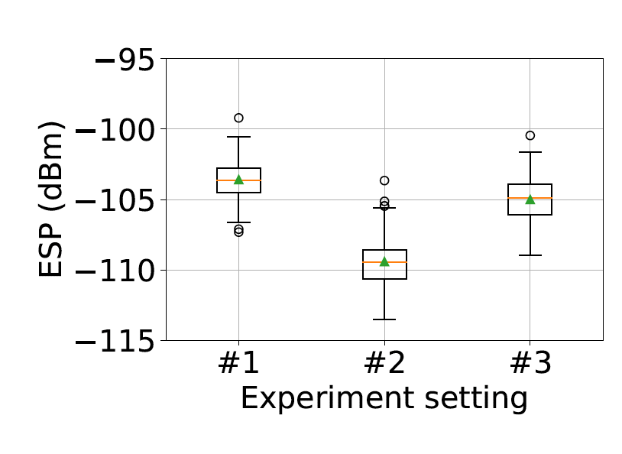
Observations
Observation 1. Signal by Diffraction
holds a large portion of received energy.
less
diffraction
less
penetration
Dead zone of diffraction interpolation
#1
#2
#3
Notes:
Then we conducted 2 more experiments to study the signal propagation pattern. First we study the impact of diffraction. For Setting 1

Slide 13
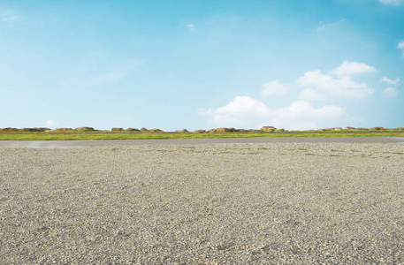
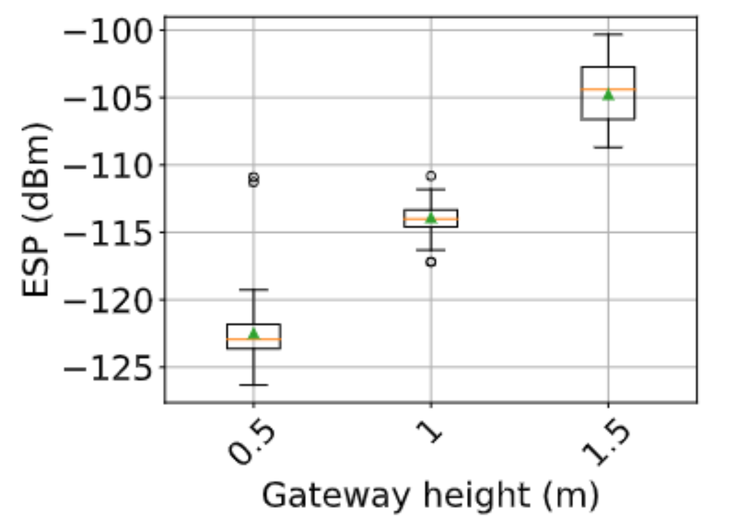
Observations
Observation 2. The Ground nearby the path introduces extra attenuation. The closer to the ground, the larger attenuation it will be.
0.5 m
0.5 m
0.5 m
0.5 m
Image source: https://xsj.699pic.com/tupian/0xt3i0.html
Notes:
Moreover, we observed that the ground may have obviously negative impact on link quality.
possible reasons

Slide 14
Summary of Observations
We need to quantify the shadowing effect of surrounding objects according to the diffraction theory.
Notes:
To summarize, we need to quantify the shadowing effect of surrounding trees and ground, according to the diffraction theory and handle the shadowing of the ground properly.

Slide 15
First Fresnel Zone: Theoretical Model for the Diffraction of Electromagnetic Wave
A
B
r
P
$$AP+BP=AB+ \frac{λ}{2}$$
d
where the radio energy is concentrated.
LoRa has a relatively large FFZ radius due to its long wavelength.
Notes:
First Fresnel Zone, abbrivated as FFZ, is a Theoretical Model for the Diffraction of Electromagnetic Wave,
Given the sender and receiver are denoted as A and B, it’s an ellipsoid with sender and receiver at 2 focuses,, respectively.
Hence it has a mathematical property that any point P on it satisfies that $AP+BP$ = AB + half the wavelength. This area is where the radio energy is concentrated.
R is
The larger the wavelength is, the larger the area of FFZ will be. LoRa has a relatively large FFZ compared to 2.4 GHz and 5GHz frequency band communications.

Slide 16
FLog Design Overview
Fitting
Inference
Orchard Profiling
Link Quality Calculation
Orchard
parameters
Output:
ESP estimation
Media
portion
3D model
PLEs
Input:
2 positions
Shadowing
Media Sampling in FFZ
PLE Fitting for each Media Type
Media
portion
Collected
positions & ESP data
Notes:
Our design , FLog has 3 major components denoted as green rectangles and works in 2-stages. When we conduct fitting.

Slide 17
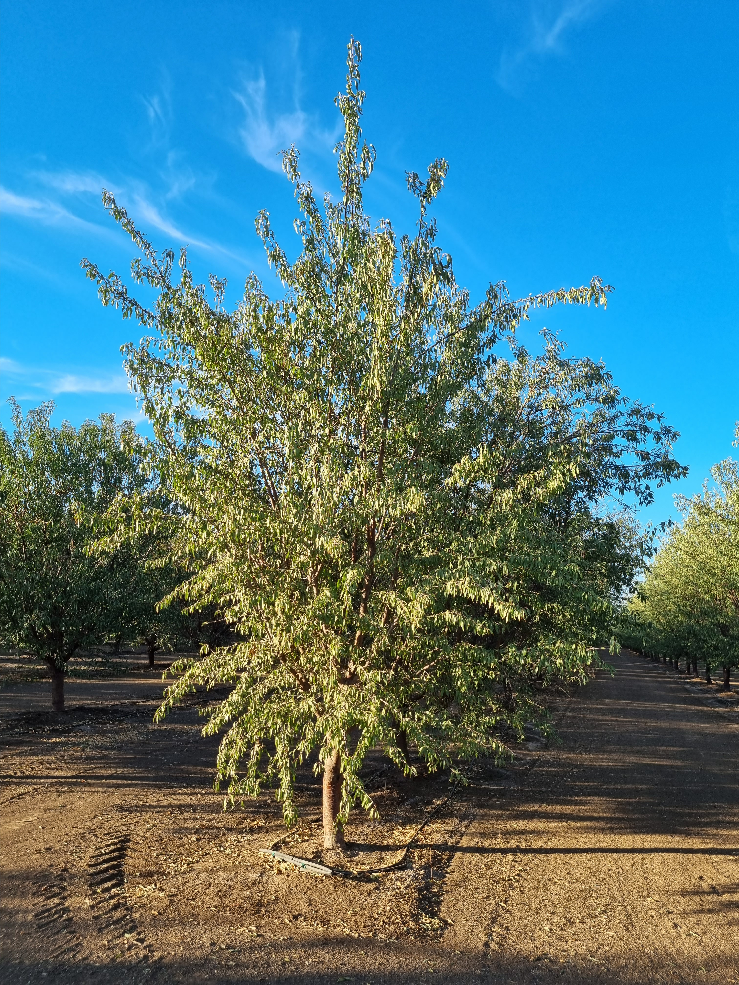
FLog Design
Profiling the shadowing effect of the foliage
$$D$$
Orchard parameters:
Tree height (main branch): $H$
Trunk height: $h$
Crown width: $D$
Trunk width: $d$
$$H$$
$$h$$
$$d$$
Manual Measurement, each 1-3 years.
Notes:
For each single tree, we can profile it as a combination of an ellipsoid and a cylinder.
4 parameters can be abstracted to represent the shapes.(capital / lower case)
These parameters are different for wild trees, but because all trees in one orchard are planted roughly the same time and aligned regularly, their shape will be extremely similar, as can be seen in satellite maps.
Note that the shape of the tree may gradually change along with the growth. So a manual re measurement is required every 1 year at the early stage and every 3 years when it enters the yield period.

Slide 18
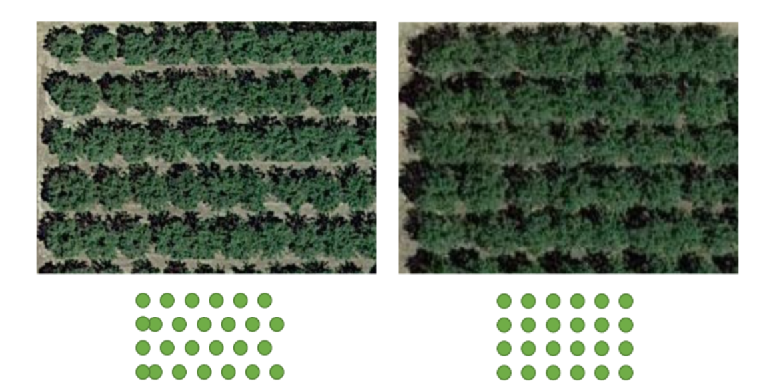
FLog Design
Orchard Layout Profiling
$$x$$
Orchard parameters:
Layout type: $T$
X-axis offset: $x$
Y-axis offset: $y$
Location Set of missed trees: ${Set}_{missed}$
$$y$$
Layout #1
Layout #2
Manual Measurement, only once.
Notes:
For the perspective of the whole orchard, it has a tidy layout of 2 certain types due to the machine planting. The distance between adjacent rows and columns are perfectly the same.
The parameters we need is
Finally, some trees might be cut off because of death or pest. FLog also takes their index pair as the input.
For these manual measurement,it is only required once for the whole life time, and right after the remove of some trees.

Slide 19
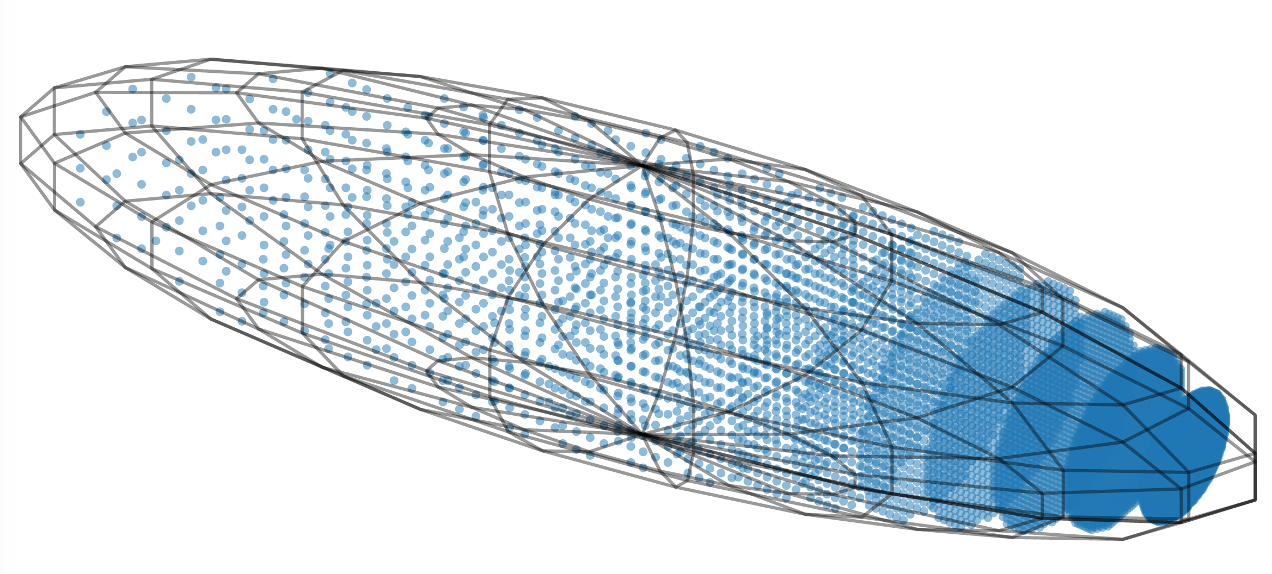
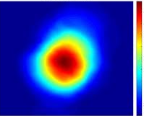
FLog Design
Shadowing media analysis by sampling
Power Flux density
$${Portion}_{open}=\frac{\# points in open space}{\# total points}$$
$${Portion}_{ground}=\frac{\# points in ground}{\# total points}$$
$${Portion}_{foliage}=\frac{\# points in foliage}{\# total points}$$
Notes:
Shadowing media analysis

Slide 20
FLog Design
Resetting
Parameter Resetting
Inference
Orchard Profiling
Link Quality Calculation
Orchard
parameters
Output:
ESP estimation
Media
portion
3D model
PLEs
Input:
2 positions
Shadowing
Media Sampling in FFZ
PLE Fitting for each Media Type
Media
portion
Collected
positions & ESP data
Notes:
When the deployment is ongoing, there might be some environmental changes that influence the shadowing effects, such as rainfall, foliage growth, and so on. Luckily, As the environment changes, the packet reception is ongoing as well and they provide real-time information for the shadowing effects. We take the 5 most recent packet information for each location to conduct the parameter resetting and PLEs can adapt well and facilitate transmission parameter configurations.

Slide 21
FLog Design
Calculating PLE for each media
Measure link quality at $M$ different sender locations.
Calculate the $PLE$ of each location from $ESP$ measurement.
Conduct least square fitting for all $M$equations to calculate $α$ and $β$.
$$\left\{\begin{aligned}{PLE}_{1}= α × {Portion}_{{open}_{1}}+β × {Portion}_{{foliage}_{1}}+{γ × Portion}_{{ground}_{1}} \\ ⋮ \\ {PLE}_{M}= α × {Portion}_{{open}_{M}}+β × {Portion}_{{foliage}_{M}}+{γ × Portion}_{{ground}_{M}}\end{aligned}\right.$$
$α$: PLE for open space.
$β$: PLE for foliage.
$γ$: PLE for ground.

Slide 22
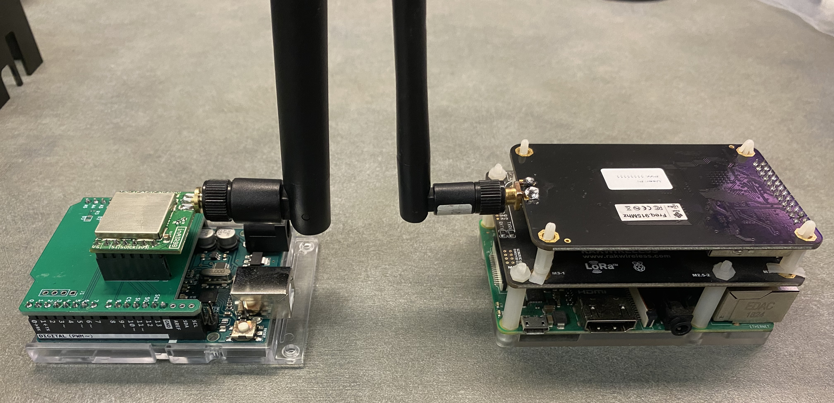
Experimental Settings
LoRa Node:
Arduino Uno
Semtech SX1276 Transceiver
Omni-directional Antenna (5 dBm gain)
LoRa Gateway:
Semtech SX1301 Digital Baseband Chip
Raspberry Pi
Omni-directional Antenna (3 dBm gain)
Tripods with adjustable heights of 0~14m for simulating the tower.
Notes:
Here are the devices we use.

Slide 23
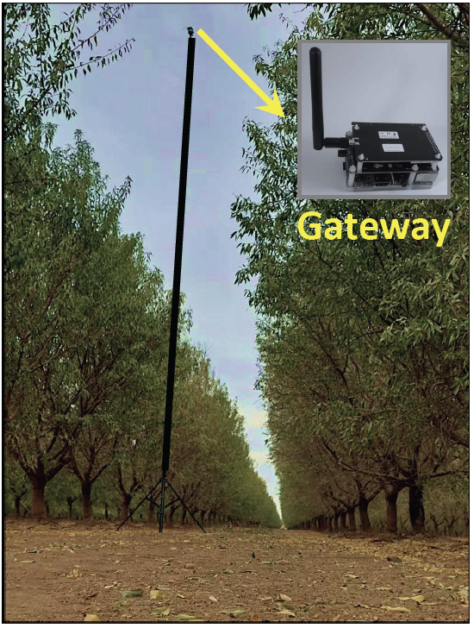
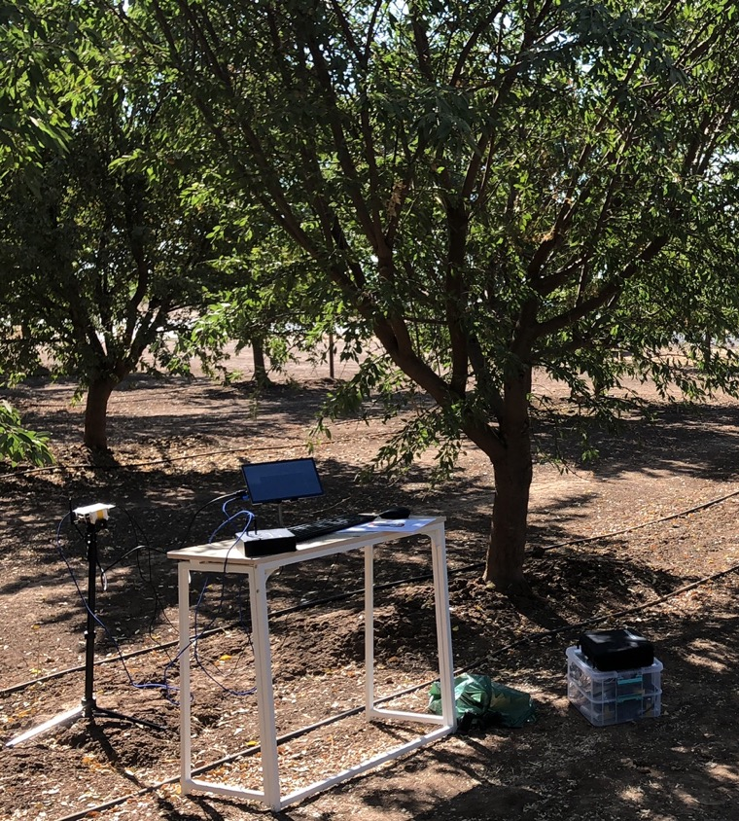
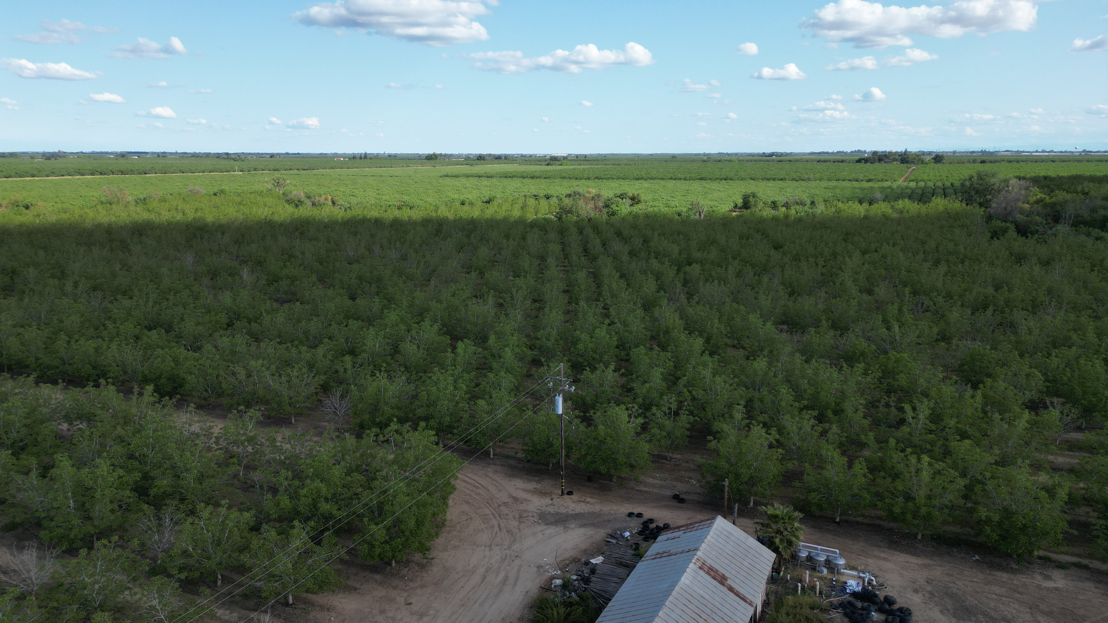
Experimental Settings
Test Places:
3 Almond Orchards,
1 Walnut Orchard,
larger than 100m*100m.
Duration:
Autumn, early spring, late spring.
Dataset:
69,173 packets with location info.
Baselines:
Log: Log-normal Shadowing Model.
LLog: Strawman Solution.
Gateway
Monitoring
Almond
Walnut

Slide 24
Evaluation Summary
Overall Performance:
Spatial Dimension
Temporal Dimension
Transient weather changes (in several hours)
Foliage density changes (year-cycled)
Long-term foliage shape changes (several years)
Generalizability:
Orchard Species
Transmission parameters
Sensing Cycles
Case Study:
Gateway Coverage Estimation
will be included in today’s talk

Slide 25
Overall Performance: Spatial Dimension
Unawareness of media portion heterogeneity
$${90}^{°}$$
$${75}^{°}$$
$${60}^{°}$$
$${45}^{°}$$
$${30}^{°}$$
$${15}^{°}$$
$$0^{°}$$
20m
Notes:
To test the performance under spatial variations, we choose 7 directions, and pick the distance of 20 m, 40m, all the way to 160m.
Besides, Log underestimated the link quality for distances of more than 100 meters. Because it ignores the foliage portion change along with the distance increase.
Here is the error Cumulative Distribution Function of the 3 methods. The average error of FLog is only 2.85 dBm, showing substantial performance improvement over others. In particular, FLog reduces the ESP estimation error of Log and LLog by 42.7% and 35.2%, respectively.

Slide 26
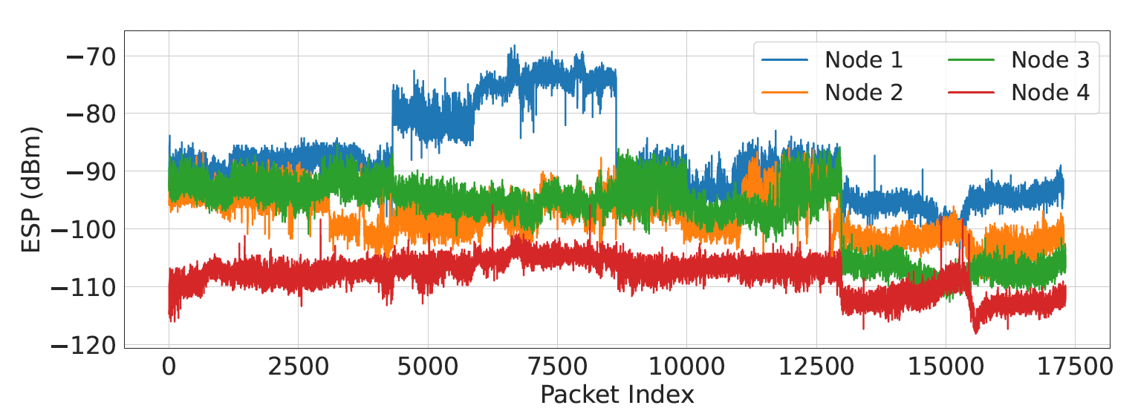
Overall Performance: Temporal Dimension
Foliage density changes (year-cycled)
Early spring
Late spring
Week 1
Week 2
Week 3
Week 4
Notes:
Apart from the autumn dataset, we deployed 4 nodes at different locations in the field and collected data for 4 more weeks during spring. The sudden change for Node 1 occurred because of a gusty wind that caused the waterproof cover behind the antenna to lift up like a reflection mirror, significantly increasing ESP. The cover was manually recovered at the second change point.
There a visible foliage growth during these 4 weeks. So we name the first 2 weeks as Early spring and last 2 weeks as late spring

Slide 27
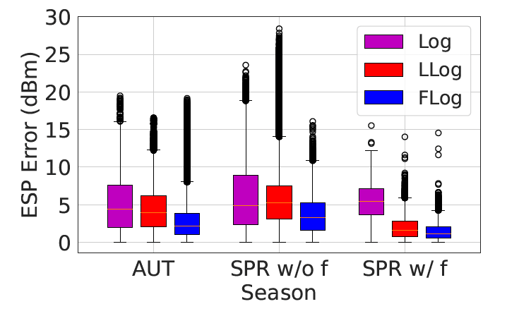
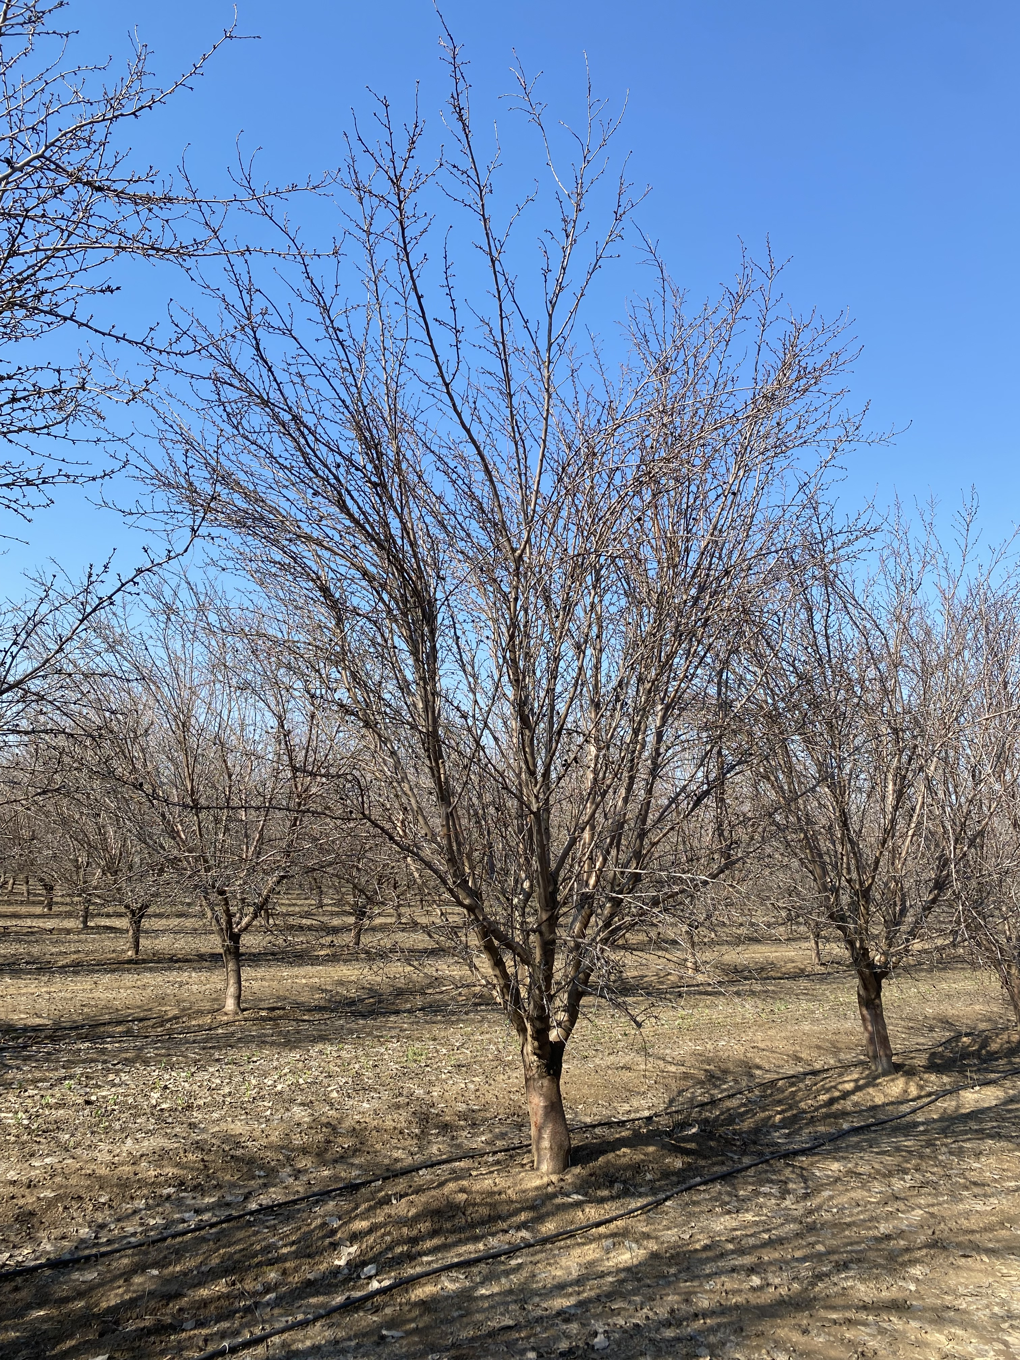
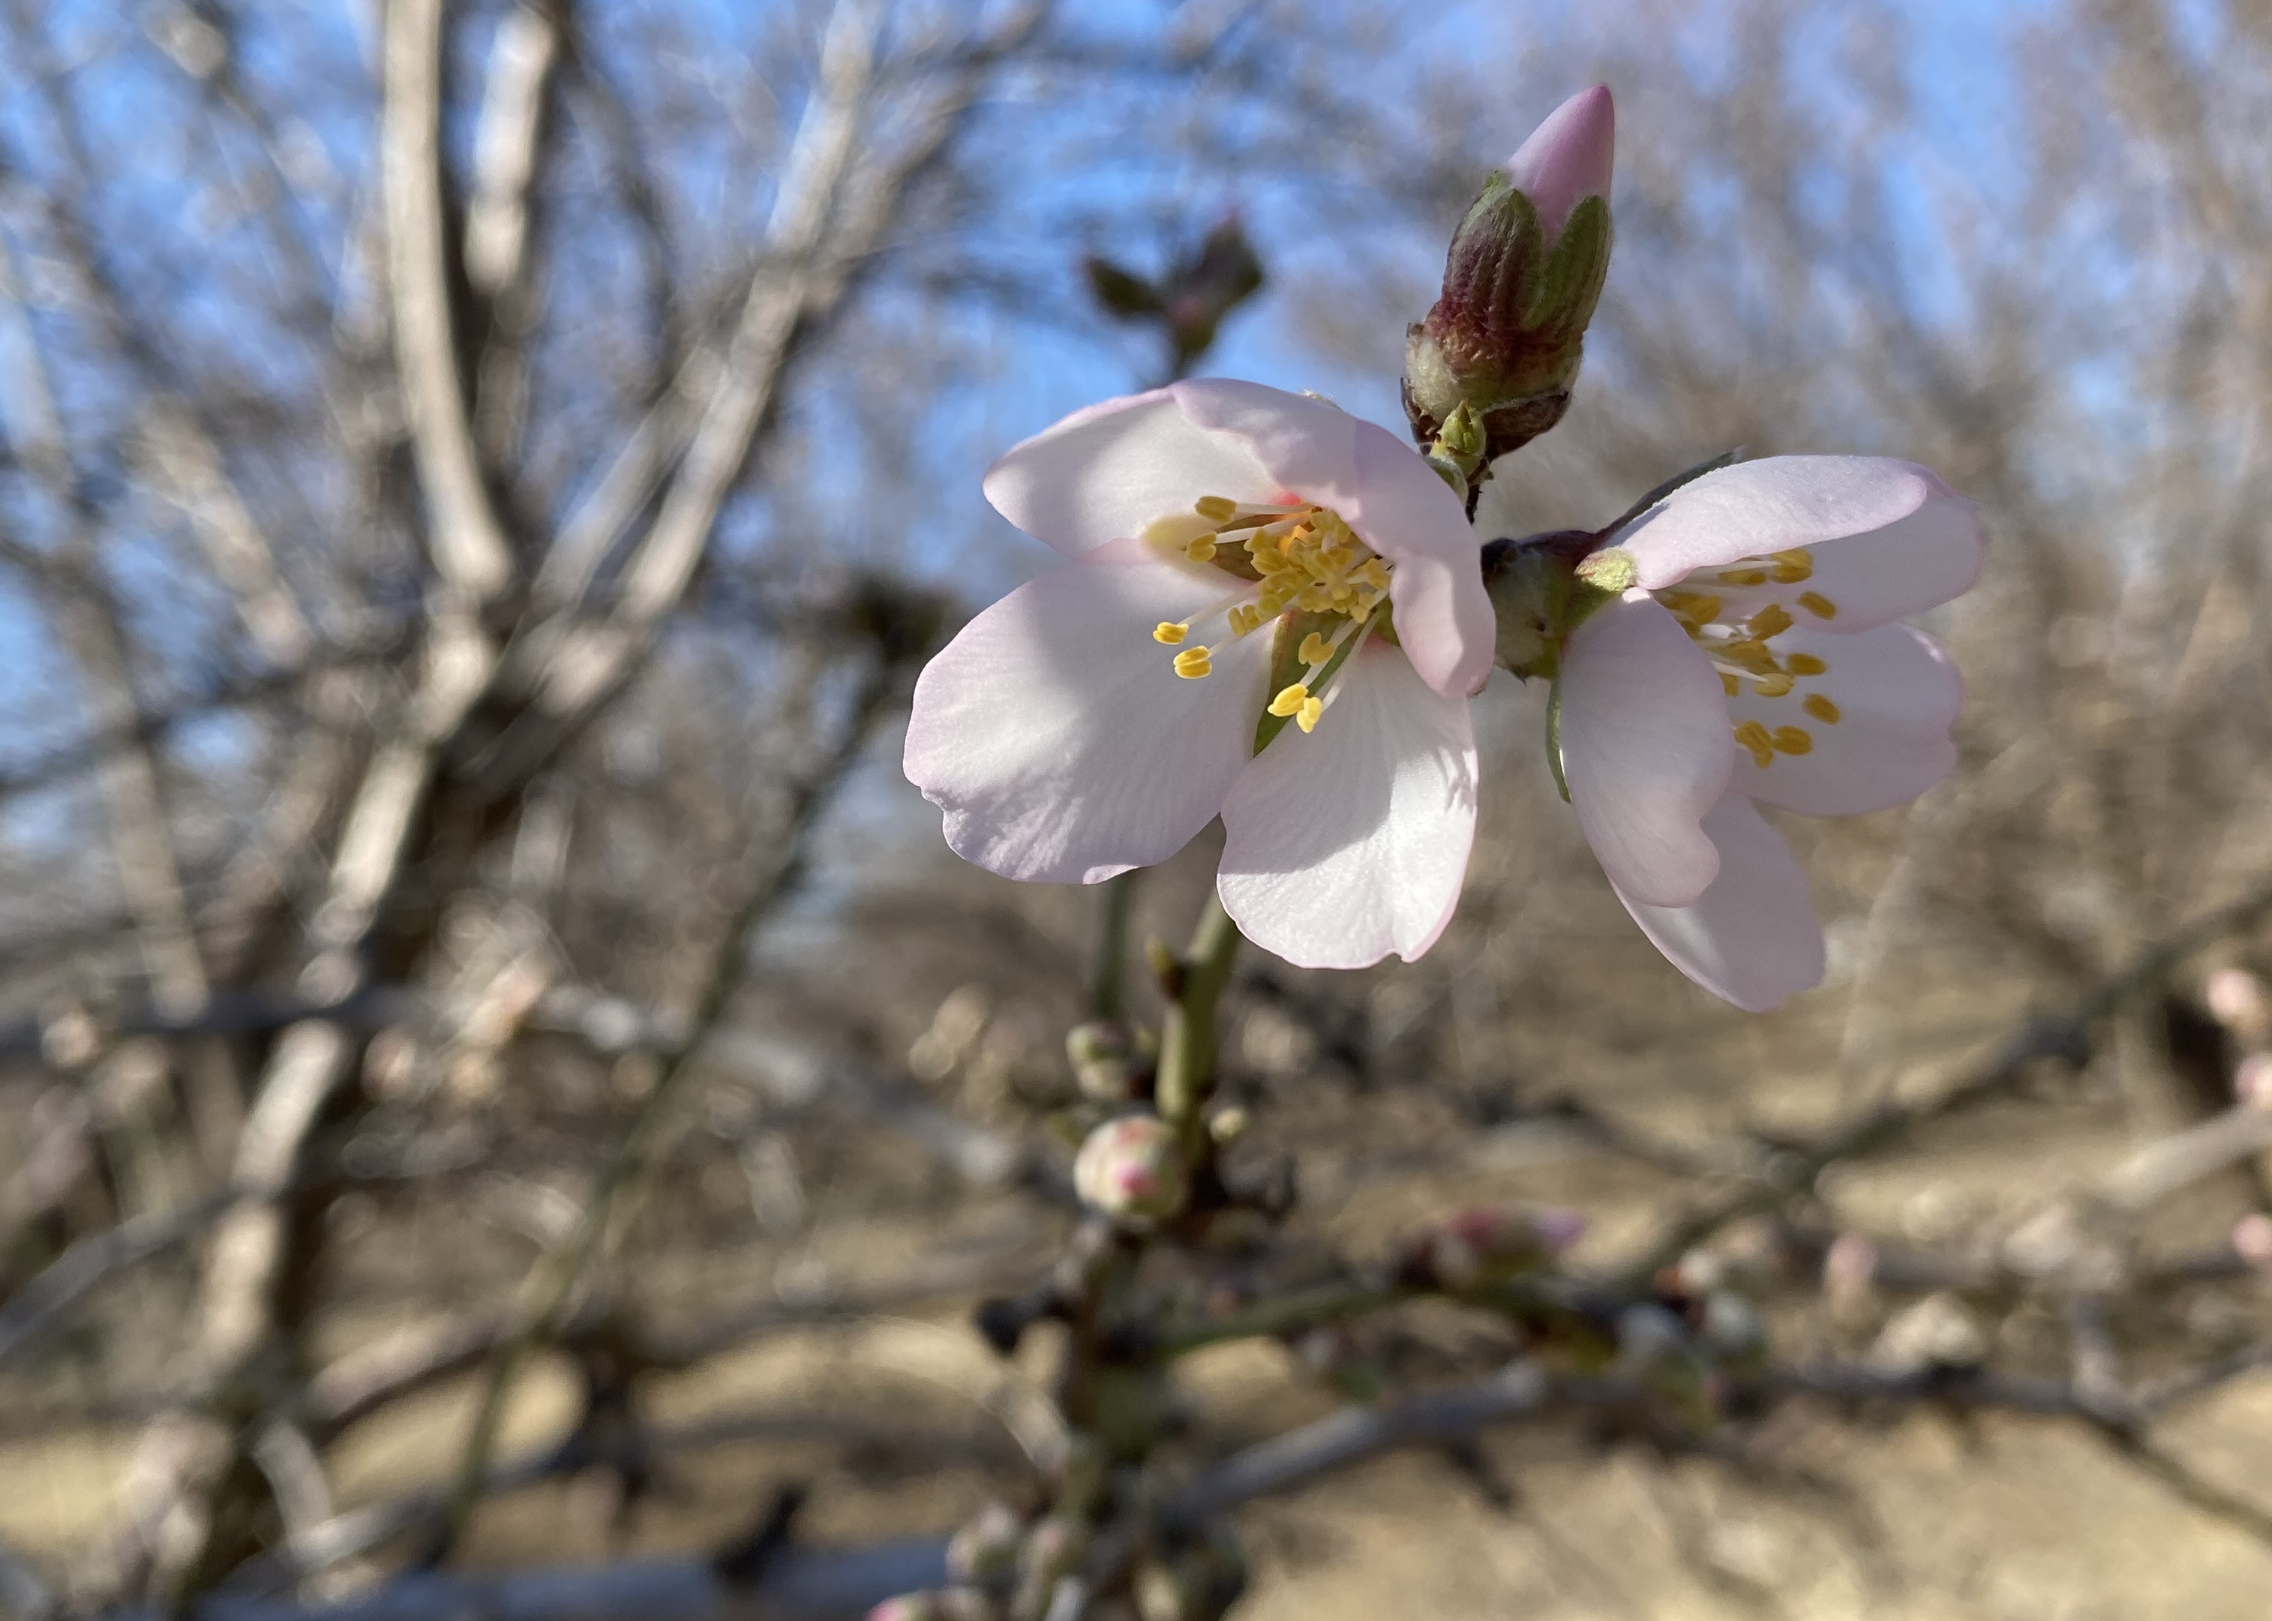
Overall Performance: Temporal Dimension
Foliage density changes (year-cycled)
Autumn
Spring without flowers & leaves
Spring with flowers & leaves
Notes:
Specifically, The biometrics are the biggest in Autumn, with full leaves and fruits. in the first 2 weeks of Spring, there are only a few buds on the tree, highly similar to the winter, but they rapidly grow into leaves and flowers in the next 2 weeks.
The right figure shows that FLog is capable of adapting well to this dynamic, with average estimation errors of 2.85 dBm, 3.61 dBm, and 1.42 dBm across three foliage density states, outperforming other baselines.

Slide 28
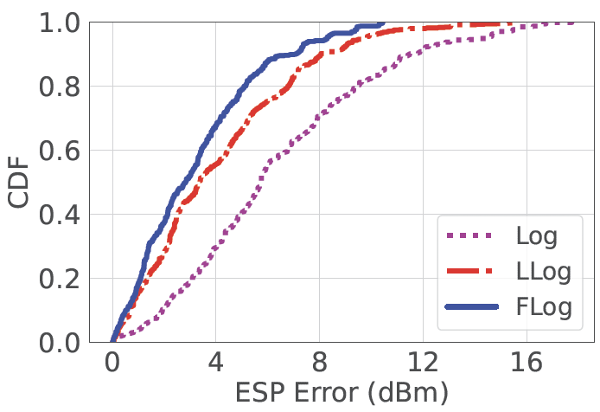
Overall Performance: Temporal Dimension
Foliage density changes (year-cycled)
Long-term foliage shape changes (several years)
$$D=5.6 m$$
$$D=5.2 m$$
$$H=6.1 m$$
$$H=4.5 m$$
Fitting
Test
Notes:
To test the performance under Long-term foliage shape changes, we use the PLEs fitted from the original almond orchard and test in another almond orchard which is planted about 4 years later in the same season, or the same foliage density. As shown in the left figure, they have visible shape difference in both width and height.
FLog’s performance was comparable to the performance when fitting and testing in the same orchard, with an average ESP error of 2.5 dBm higher than to 3.4 dBm for Log.

Slide 29
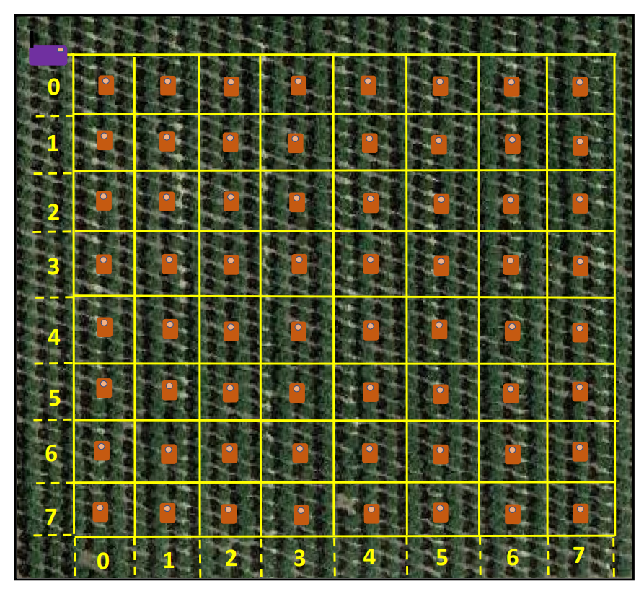
Case Study: Gateway Coverage Estimation
Log
Error: 26%
groundtruth
LLog
Error: 46%
Most Similar!
FLog
Error: 14%
Packet Delivery Rate for each location
Notes:
To study the practical performance of Flog, we conducted a case study on estimating the gateway coverage for all node locations. We suppose a fixed gateway location and split the orchard area into 8 by 8 grids. Each grid is 19.2 meters by 19.2 meters. We use 3 models to estimate the packet delivery rate for each grid. Here is the groundtruth collected site by site. The coverage radius is about 140 meters with variations in different direction.

Slide 30
Summary
We investigated the propagation pattern of the LoRa signal in the orchards.
We proposed FLog, a log-normal-based propagation model by extracting spatial features of shadowing effects in the First-Fresnel-Zone.
Extensive experiments show the efficiency and scalability of Flog and its performance in applications like gateway coverage estimation.
Notes:
Thank you

