Slide 1

LLDPC: A Low-Density Parity-Check Coding Scheme for LoRa Networks
Kang Yang and Wan Du
﻿Department of Computer Science and Engineering University of California, Merced

Slide 2


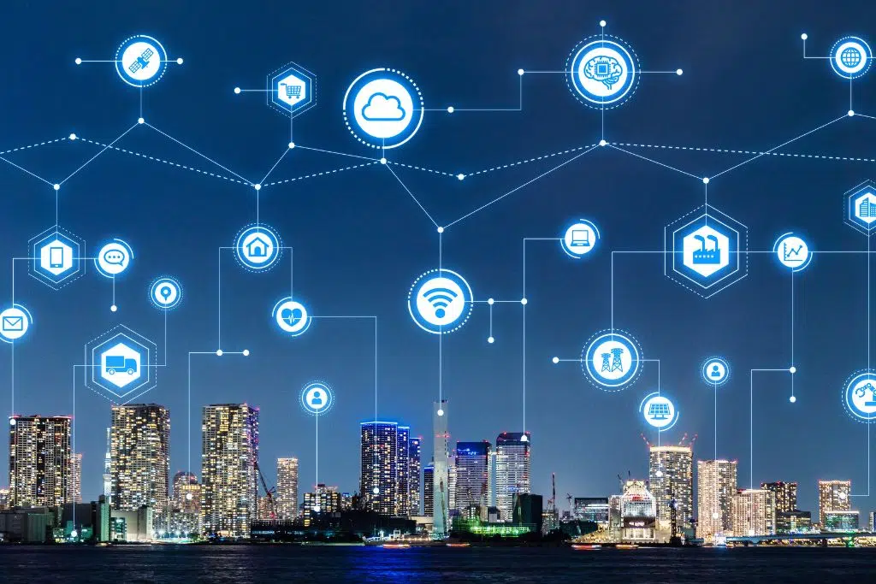

Overview
Smart Farming^{[1]}
Smart City^{[2]}
Wide Area Coverage
Long Battery Life
Low Data Rate
[1] https://iotdesignpro.com/articles/smart-farming-iot-applications-in-agriculture
[2] https://earth.org/smart-city-technologies/

Slide 3
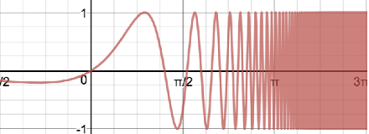
Overview
LoRa Primer
Payload Bits: 1 1 0 1
Payload Bits: 1 1 0 1
Forward Error Correction (FEC) Encoding
FEC Decoding
1 1 0 1 1 0 0
0 1 0 1 1 0 0
Chirp Spread Spectrum (CSS) Modulation
CSS Demodulation
Sender
Channel
Receiver

Slide 4
Motivation
Hamming Codes – Limited Error Correction Capacity
PRR (Packet Reception Ratio) and BRR (Bit Reception Ratio)
Low PRR but high BRR, indicating a small number of erroneous bits.
Can we develop a more efficient error correction code for LoRa?

Slide 5
Motivation
Low-Density Parity-Check (LDPC) Codes^{[4]}
Capacity-Achieving: Supports data rates close to the Shannon limit in Gaussian channels
Popularity: 5G-NR, DVB-S/S2, 802.11, Near-Earth, Deep space
​ Light-Weight Encoding: Same as Hamming codes, only XOR operation
[4] Srikar Kasi and Kyle Jamieson. Towards quantum belief propagation for LDPC decoding in wireless networks. In ACM MobiCom, 2020.

Slide 6
Design of LLDPC
LLDPC
Integrating LDPC Codes into LoRa

Slide 7


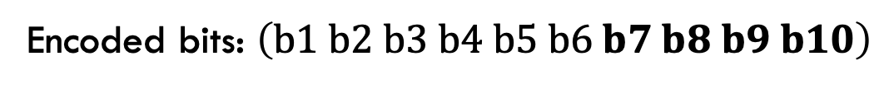
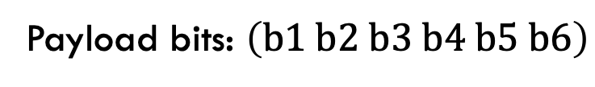
LDPC Codes Primer
Encoding - XOR Operation
Payload bits: $\left(b1 b2 b3 b4 b5 b6\right)$
Encoded bits: $\left(b1 b2 b3 b4 b5 b6 b7 b8 b9 b10\right)$
b1 | b2 | b3 | b4 | b5 | b6 | b7 | b8 | b9 | b10
1 | 1 | 1 | 0 | 0 | 0 | 1 | 0 | 0 | 0
0 | 0 | 0 | 1 | 1 | 1 | 0 | 1 | 0 | 0
1 | 0 | 0 | 1 | 0 | 0 | 0 | 0 | 1 | 0
0 | 1 | 0 | 0 | 1 | 0 | 0 | 0 | 0 | 1
$$\left\{\begin{aligned}b1⊕b2⊕b3⊕b7=0 \\ b4⊕b5⊕b6⊕b8=0 \\ . b1⊕b4⊕b9=0 \\ . b2⊕b5⊕b10=0\end{aligned}\right.$$
$$\left\{\begin{aligned}b1⊕b2⊕b3=b7 \\ b4⊕b5⊕b6=b8 \\ . b1⊕b4=b9 \\ . b2⊕b5=b10\end{aligned}\right.$$
Parity-check matrix H

Slide 8


















LDPC Codes Primer
Decoding – Soft Belief Propagation (SBP) Algorithm
b1 | b2 | b3 | b4 | b5 | b6 | b7 | b8 | b9 | b10
1 | 1 | 1 | 0 | 0 | 0 | 1 | 0 | 0 | 0
0 | 0 | 0 | 1 | 1 | 1 | 0 | 1 | 0 | 0
1 | 0 | 0 | 1 | 0 | 0 | 0 | 0 | 1 | 0
0 | 1 | 0 | 0 | 1 | 0 | 0 | 0 | 0 | 1
Parity-Check Matrix H =
b$1⊕b4⊕b9=0$
b$1⊕b2⊕b3⊕b7=0$
$$b2⊕b5⊕b10=0$$
b$4⊕b5⊕b6⊕b8=0$
$$f_{1}$$
$$f_{2}$$
$$f_{3}$$
$$f_{4}$$
Factor nodes
Factor
Graph
$$b_{1}$$
$$b_{2}$$
$$b_{3}$$
$$b_{4}$$
$$b_{5}$$
$$b_{6}$$
$$b_{7}$$
$$b_{8}$$
$$b_{9}$$
$$b_{10}$$
Variable nodes

Slide 9




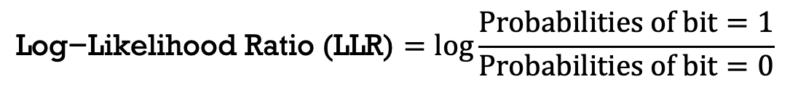

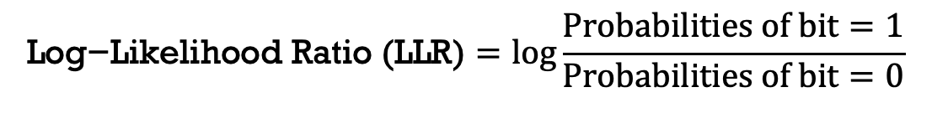





LDPC Codes Primer
Decoding – SBP Algorithm
LDPC Decoding by the SBP Algorithm
$$f_{1}$$
$$f_{2}$$
$$f_{3}$$
$$f_{4}$$
b1 | b2 | b3 | b4 | b5 | b6 | b7 | b8 | b9 | b10
-0.6 | -0.8 | -0.7 | -0.1 | 0.1 | 0.9 | -0.7 | 0.6 | -0.5 | 0.5
$$\text{Log}\text{−}\text{Likelihood} \text{Ratio}\text{ (}\text{LLR}\text{)}=﻿log\frac{Probabilities of bit=1}{Probabilities of bit=0}$$
$$b_{1}$$
$$b_{2}$$
$$b_{3}$$
$$b_{4}$$
$$b_{5}$$
$$b_{6}$$
$$b_{7}$$
$$b_{8}$$
$$b_{9}$$
$$b_{10}$$
-0.6 | -0.8 | -0.7 | -0.1 | 0.1 | 0.9 | -0.7 | 0.6 | -0.5 | 0.5
$$\text{Log}\text{−}\text{Likelihood} \text{Ratio}\text{ (}\text{LLR}\text{)}=﻿log\frac{Probabilities of bit=1}{Probabilities of bit=0}$$
Demodulation
Details of SBP in the paper.
Receiver

Slide 10
Design of LLDPC
Payload Bits
Payload Bits
LDPC Encoding by Simple XOR Operation
LDPC Decoding
Encoded Bits
LoRa CSS Modulation
LoRa CSS Demodulation
Sender
Channel
Receiver

Slide 11

Design of LLDPC
Challenge 1 – No LLR for LoRa CSS Demodulation
Received Chirp
BW
De-Chirping
Time
FFT (Fast Fourier Transform)
$$×$$
1 63 128
Down-Chirp
Frequency Bin Index
Binary Sequence
0 0 1 1 1 1 1 1
No LLR (Log-Likelihood Ratio).

Slide 12
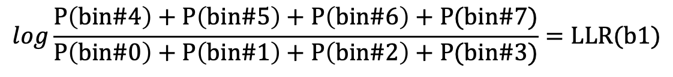
Design of LLDPC
Solution 1 – Amplitude Spectrum-based LLR extractor
Insight: All frequency bins have the impact on the bit value
Index | 0 | 1 | 2 | 3 | 4 | 5 | 6 | 7
Binary | 000 | 001 | 010 | 011 | 100 | 101 | 110 | 111
b1 | 0 | 0 | 0 | 0 | 1 | 1 | 1 | 1
b2 | 0 | 0 | 1 | 1 | 0 | 0 | 1 | 1
b3 | 0 | 1 | 0 | 1 | 0 | 1 | 0 | 1
SoftMax
0 1 2 3 4 5 6 7
Frequency Bin Index
Probability distribution of eight bins in a symbol which contains 3 bits when SF = 3.
The sum of the probabilities of believing b1 =1
$$log\frac{P\left(bin\#4\right)+P\left(bin\#5\right)+P\left(bin\#6\right)+P(bin\#7)}{P\left(bin\#0\right)+P\left(bin\#1\right)+P\left(bin\#2\right)+P(bin\#3)}=LLR(b1)$$
The sum of the probabilities of believing b1 = 0

Slide 13
Design of LLDPC
Challenge 2 – Low Decoding Efficiency
The CDF (Cumulative Distribution Function) of the absolute LLR value for erroneous bits.
The pre-decoding and post-decoding BER (Bit Error Ratio) before and after LDCP decoding.
Identify erroneous bits to reduce their LLR.

Slide 14
Design of LLDPC
Solution 2 – Symbol-Aware LLR Enhancement Module
Insight: If there are erroneous bits, its symbol is wrongly demodulated
Wrongly Demodulated Symbol Detection Model
SoftMax
0 1 2 3 4 5 6 7
If the symbol is incorrectly demodulated.
Frequency Bin Index
Probability p
b1 | b1 | b3
0.9 | -0.6 | -0.3
0.9p | -0.6p | -0.3p
Amplitude Spectrum-based LLR extractor
Original LLR
Enhanced LLR
Details of symbol detection model in the paper.

Slide 15
Design of LLDPC
Solution 2 – Symbol-Aware LLR Enhancement Module
The CDF of the absolute LLR for erroneous bits w/o and w/ symbol-level information.

Slide 16

Design of LLDPC
Challenge 3 – High Decoding Latency
SBP needs a large number of iterative update, which causes long decoding latency
Packet transmission
Receiving window #1
Receiving window #2
 | CR=4/5 | CR=4/6 | CR=4/7
Decoding latency | 2.51 s | 3.27 s | 5.46 s
LoRa Node Time Line
Transmission
Delay #1 (1s)
$$>2 s$$
Time consumption of the SBP to decode one packet for different CRs on the Raspberry Pi 3.
Delay #2 (2s)
There are one or two seconds to reply ACK (Acknowledgement) for receivers.
Cannot meet the time constraint.

Slide 17
Design of LLDPC
Solution 3 – GNN-based Belief Propagation Algorithm
Insight: If a trained model is available, the Graph Neural Network-based methods^{[5]} require just one inference to output results.
K layers
1
0
…
0
1
Feature Extraction
…
Classifier Layer
GNN Layer
GNN Layer
The updated LLR of all bits
The LLR of all variable nodes
[5] Zhen Zhang, Fan Wu, and Wee Sun Lee. Factor graph neural networks. In NeurIPS, 2020.

Slide 18

Design of LLDPC
Solution 3 – GNN-based Belief Propagation Algorithm
 | CR=4/5 | CR=4/6 | CR=4/7
GNN-based BP | 0.434 s | 0.628 s | 1.502 s
LLDPC | 0.548 s | 0749 s | 1.871 s
$$<2 s$$
Time consumption of GNN-based BP and LLDPC to decode one packet for different CRs on Raspberry Pi 3.

Slide 19
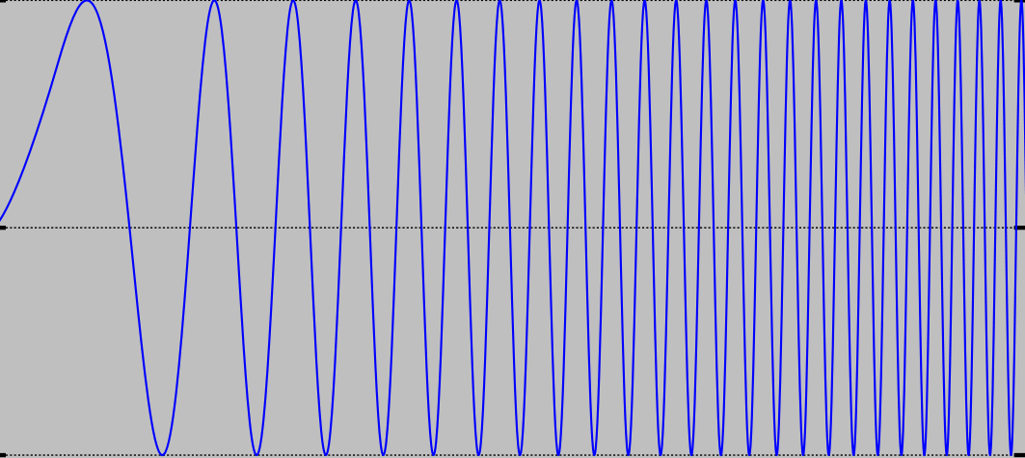
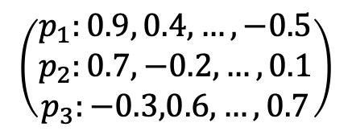
Design of LLDPC
Put All Together for LDPC Decoding at Receiver
De-chirping
& FFT
1 | 0 | … | 0 | 1
Received LoRa PHY samples at receiver
GNN-based belief propagation
Amplitude spectrum
Spectrum-based LLR extractor
LLR
Symbol-aware LLR enhancement
Enhanced LLR
$$\left(\begin{aligned}p_{1}:0.9, 0.4, …, −0.5 \\ p_{2}:0.7, −0.2, …, 0.1 \\ p_{3}:−0.3,0.6, …, 0.7\end{aligned}\right)$$

Slide 20
Evaluation
Experiment Setup
  Overall performance
  Ablation study
  Performance under different settings
  Performance on the real dataset

Slide 21
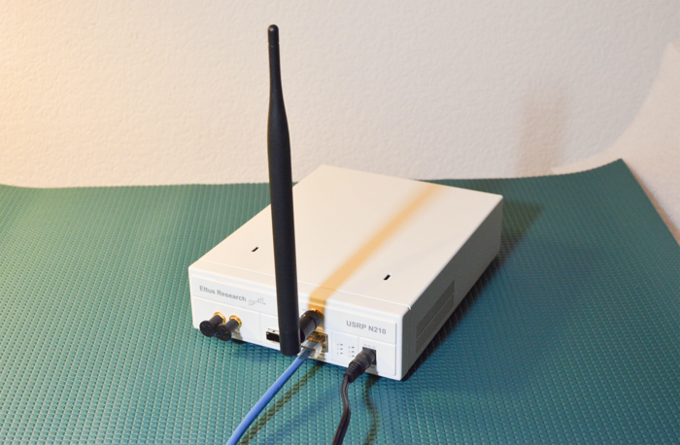
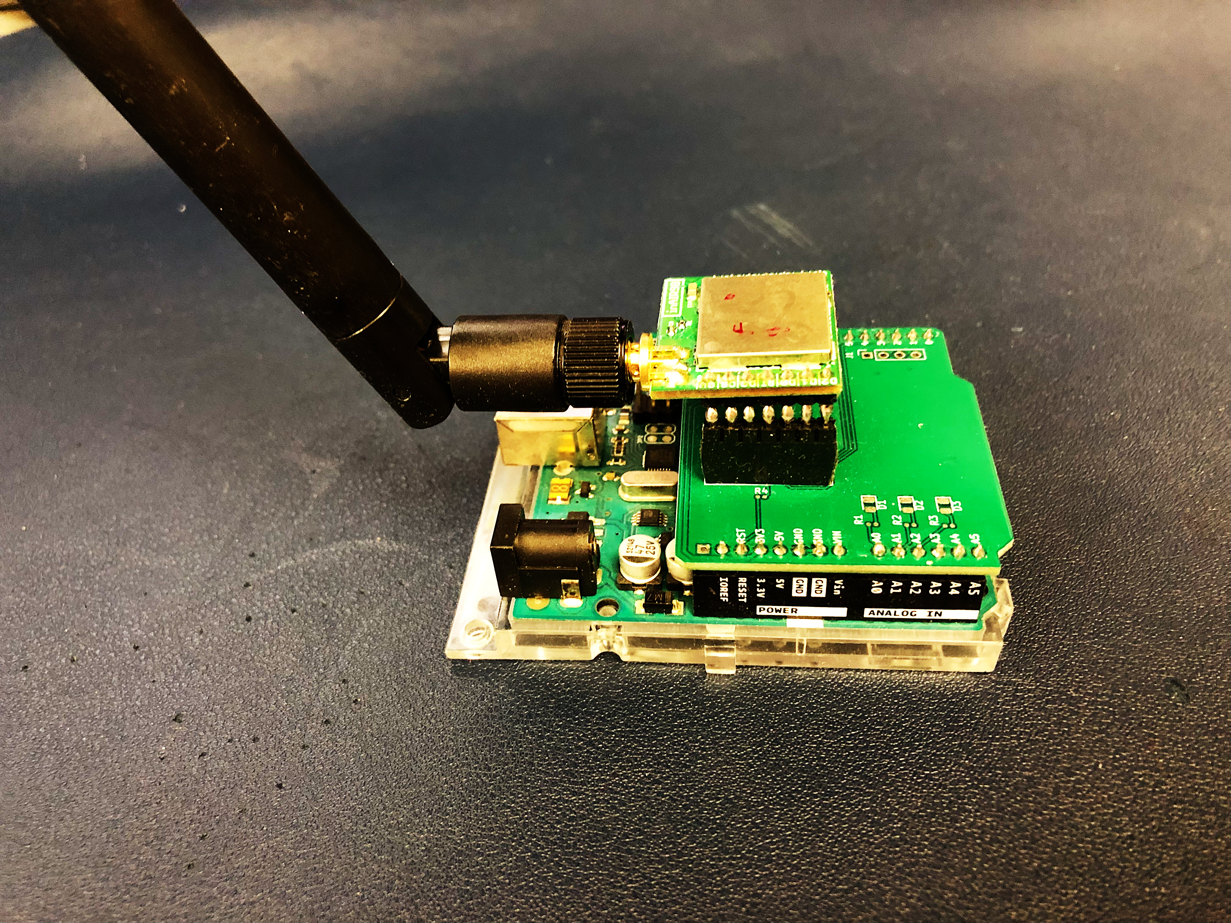
Evaluation
The In-Field Testbed
USRP N210
LoRa nodes

Slide 22
Evaluation
Performance in the In-Field Testbed
The BER at ten different locations on a campus-scale testbed.
LLDPC decreases the BER by an average of 57.6% over Hamming.

Slide 23
Summary
LLDPC, integrating LDPC codes into LoRa.
Three challenges (no LLR, low decoding efficiency, and high decoding latency) and corresponding solutions.
Extensive data-driven experiments.
Code: https://github.com/kangyang73/LLDPC-SenSys22.

Slide 24
Thank You

